Slide 1
What’s New in
Myasthenia Gravis

Slide 2
Introduction to MG
MG is an autoimmune disease of the the neuromuscular junction. It is characterized by variable weakness in skeletal muscle (ocular, bulbar, limb and respiratory):
Fatigable Weakness
Muscle weakness that fluctuates with rest and activity
Selective Vulnerability
Muscle weakness in eyes, eyelids, shoulder, hip, breathing muscles (diaphragm), neck, chewing/swallowing muscles
Muscle weakness results in double vision, obstruction of vision, trouble chewing/swallowing, trouble talking, trouble breathing, and dysfunction of arms/legs
Incidence of 8-10 cases/million/year¹
Prevalence of 200 cases/million^{1,2}
Est: 70,000 people with MG in US
Age of onset: Women < 40 years; Men > 50 years
Gilhus, 2016
Phillips, 2003
Notes:
References
Gilhus NE. Myasthenia Gravis. Longo DL, ed. N Engl J Med. 2016;375(26):2570-2581. doi:10.1056/NEJMra1602678
Phillips LH. The Epidemiology of Myasthenia Gravis. Ann N Y Acad Sci. 2003;998(1):407-412. doi:10.1196/annals.1254.053
Notes
The prevalence of the disease has been increasing since the mid-20thcentury, possibly due to better recognition of the condition, aging of the population, and the longer life span of affected patients.

Slide 3
Overview of MG subgroups
Subgroups influence therapeutic decisions and prognosis.
1. Gilhus, 2016
Notes:
References
1. Gilhus NE. Myasthenia Gravis. Longo DL, ed. N Engl J Med. 2016;375(26):2570-2581. doi:10.1056/NEJMra1602678
Notes
MuSK denotes muscle-specific kinase, and LRP4 lipoprotein receptor–related protein 4.
Among patients who have MG with acetylcholine receptor antibodies, the age at onset has a bimodal pattern, supporting the use of a cutoff age of 50 years to distinguish between early-onset and late-onset disease.
Autoimmune juvenile MG (in the early onset subgroup) accounts for approximately 10-15% of cases in North America.

Slide 4
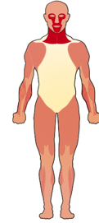
MG clinical forms
The two main clinical forms of MG are:
Ocular myasthenia - weakness is limited to the eyelids and extraocular muscles.
Generalized disease - weakness commonly affects ocular muscles, but it also involves a variable combination of bulbar, limb, and respiratory muscles.
Additional forms of MG are:
Neonatal MG - a transient form in neonates that results from transplacental passage of maternal antibodies that interfere with function of the neuromuscular junction.
Congenital MG - nonimmune-mediated forms that may result from mutations that adversely affect neuromuscular transmission.
Image courtesy of Michael Hehir, MD
Grob, et al., 2008
Notes:
References
1. Grob D, Brunner N, Namba T, Pagala M. Lifetime course of myasthenia gravis. Muscle Nerve. 2008;37(2):141-149. doi:10.1002/mus.20950
Notes
A population-based case-control study found that women in the postpartum period had an increased risk for the clinical onset of MG.

Slide 5
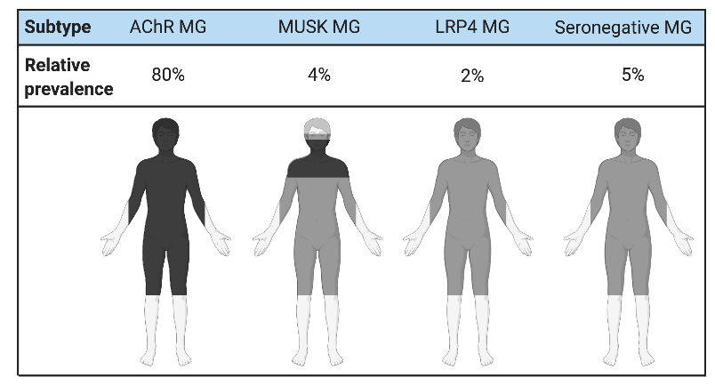
MG antibody status
Seropositive MG - Patients have detectable antibodies to AChR, MuSK, or LRP4
~50% of patients with ocular myasthenia are seropositive
~90% of patients with generalized disease are seropositive
Seronegative MG – Patients lack AChR, MuSK, or LRP4 antibodies on standard assays
Figure adapted from reference #1. Re-created with BioRender.com
Gilhus, 2015
5
Notes:
References
1. Gilhus NE, Verschuuren JJ. Myasthenia gravis: subgroup classification and therapeutic strategies. Lancet Neurol. 2015;14(10):1023-1036. doi:10.1016/S1474-4422(15)00145-3
Notes
AChR - acetylcholine receptor
MuSK - muscle-specific receptor tyrosine kinase
LRP4 - lipoprotein receptor-related protein 4
Anti-MuSK (Muscle Specific Kinase)
MG with anti-MuSK antibodies accounts for 1 to 10% of cases.
1/3 Seronegative MG (7% total)
IgG4 antibody (Doesn’t Link Complement)
Est Prevalence MuSK MG
4000 - 5000 patients in US
2003: Estimated 60-70,000 people with MG in US (Phillips 2003)
Patients with MG and anti-MuSK antibodies, as compared with patients without these antibodies, have more severe weakness, sometimes with muscle atrophy, and have marked symptoms from facial and bulbar muscles. Limb weakness and ocular weakness are less common and fluctuations in muscle strength are less pronounced than in disease characterized by AChR antibodies.
Anti-LRP4
LRP4 antibodies are present in 1-3% of all patients with MG. Such patients tend to have only mild-to-moderate symptoms. The clinical presentation and response to treatment for patients with LRP4 antibodies is similar to patients with AChR+ MG and seronegative MG.
Patients have been observed with both concurrent AChR antibodies and LRP4 antibodies and concurrent anti-MuSK antibodies and LRP4 antibodies. (Recommend not discussing phenotype of these patients in a basic talk).
Diagnostic testing
After standard testing with commercially available kits, 10-15% of patients remain seronegative. Cell-based assays for antibody detection are more sensitive than serum tests because the antigens expressed on cell membranes can be clustered and maintain their natural conformation. Cell-based assays have been developed for AChR, MUSK, and LRP4 antibodies. 1/3 of patients with gMG who are seronegative on standard testing are seropositive on cell-based testing.

Slide 6
Anti-MuSK MG is a severe form of MG
Anti-MuSK (Muscle Specific Kinase):
1/3 Seronegative MG (7% total)
4000 - 5000 patients in US
Age of onset
Females - 36.7 ± 18.7 years
Males - 44.1 ± 17.0 years
In 64% of patients, onset was before 40 years of age.
Worst MGFA Status
89% MGFA 3-5
(Moderate Weakness or worse)
44% MGFA Grade 4/5
(Severe Weakness or worse)
28% Respiratory Crisis
Many Progress Rapidly within 2 – 3 weeks
Pasnoor, et al., 2010
6
Notes:
References
Pasnoor M, Wolfe GI, Nations S, et al. Clinical findings in MuSK-antibody positive myasthenia gravis: A U.S. experience. Muscle Nerve. 2010;41(3):370-374. doi:10.1002/mus.21533
Clifford KM, Hobson-Webb LD, Benatar M, et al. Thymectomy may not be associated with clinical improvement in MuSK myasthenia gravis. Muscle Nerve. 2019;59(4):404-410. doi:10.1002/mus.26404
Notes
Thymectomy may not be associated with clinical improvement in MuSK MG.²

Slide 7
MG Disease Progression
Ptosis and diplopia are common initial symptoms, but disease remains restricted to ocular muscles in a minority of patients
In 15% of patients with MG, symptoms and signs are confined to ocular muscles.
In most patients with purely ocular MG 2 years after the start of symptoms, disease will persist as a focal eye-muscle weakness
In patients with ocular MG, presence of AChR-binding antibodies slightly increases the risk of subsequent generalized disease¹
90% of patients with MG experience the maximal amount of weakness within the first 2 symptomatic years
Patients with anti-MuSK antibody+ MG often experience maximal weakness in the first symptomatic year
Peeler, et al., 2015
7
Notes:
References
1. Peeler CE, De Lott LB, Nagia L, Lemos J, Eggenberger ER, Cornblath WT. Clinical Utility of Acetylcholine Receptor Antibody Testing in Ocular Myasthenia Gravis. JAMA Neurol. 2015;72(10):1170. doi:10.1001/jamaneurol.2015.1444
Notes
Ocular Myasthenia Gravis
Weakness Restricted to Eyelid and Extra-Ocular Muscles
40-70% Generalize by 2 years
Predilection for Older Patients
AChR Ab 50 – 70%

Slide 8
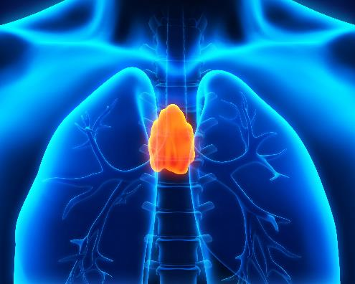
MG thymic status
The thymus has a key role in inducing anti-AChR antibody production in patients with MG.
~10-15% of patients with MG have an underlying thymoma, and the prevalence increases with increasing age.
In patients with ocular MG, presence of thymoma increases the risk of subsequent generalized disease¹
Imaging of the thymus with a CT or chest MRI is recommended for patients with AChR and Seronegative MG
2/3 of patients with MG have generalized early- or late-onset disease and no thymoma.
Li, et al., 2018
Gilhus, et al., 2015
8
Notes:
References
Li F, Hotter B, Swierzy M, Ismail M, Meisel A, Rückert J-C. Generalization after ocular onset in myasthenia gravis: a case series in Germany. J Neurol. 2018;265(12):2773-2782. doi:10.1007/s00415-018-9056-8
Gilhus NE, Verschuuren JJ. Myasthenia gravis: subgroup classification and therapeutic strategies. Lancet Neurol. 2015;14(10):1023-1036. doi:10.1016/S1474-4422(15)00145-3
Notes
Imaging of thymus is not recommended to anti-MuSK MG.

Slide 9
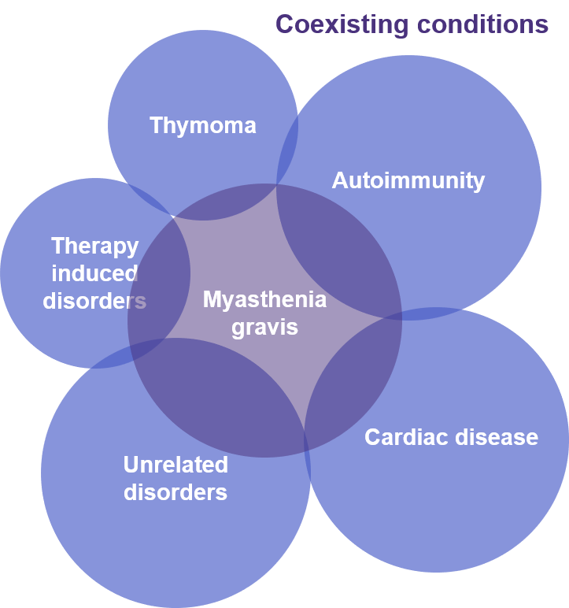
Risk factors
Thymic status and HLA pattern help to distinguish MG subgroups.
Early-onset MG
Often characterized by thymic hyperplasia
Associated with HLA-DR3, HLA-B8, and non-HLA genes that influence immune system
3 times as likely to be diagnosed in females as it is in males
Coexisting autoimmune disorders are common
Late-onset disease
Often characterized by thymic atrophy
Associated with HLA-DR2, HLA-B7, and HLA-DRB1 15.01
Males slightly outnumber females in the late-onset group
Patients with MG commonly have coexisting conditions related to their disease.
Autoimmune thyroid disease, systemic lupus erythematosus, rheumatoid arthritis, neuromyelitis optica
Gilhus, 2016
Notes:
References
1. Gilhus NE. Myasthenia Gravis. Longo DL, ed. N Engl J Med. 2016;375(26):2570-2581. doi:10.1056/NEJMra1602678
Notes
Thymic status and HLA pattern represent strong subgroup markers, probably pointing directly to variation in pathogenic pathways.
Approximately 15% of patients have a second autoimmune disease, which occurs most frequently in patients with early-onset MG and thymic hyperplasia. Thyroiditis is the most common coexisting condition, followed by systemic lupus erythematosus and rheumatoid arthritis. In patients with ocular myasthenia, thyroid disease is especially common.

Slide 10
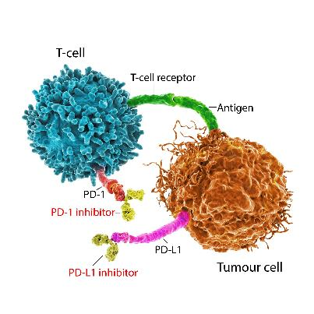
Risk factors (continued)
Checkpoint inhibition in cancer patients
Reports of MG caused by checkpoint inhibition therapy in cancer patients are rare but growing
50-60% of these cases are AChR and MuSK Negative
It takes a mean time of 2 – 4 cycles (up to 14 weeks) of checkpoint inhibition therapy to develop neurological complications
Concurrent myositis is common
Treatment for MG caused by checkpoint inhibition may be different than other MG subgroups
Immune checkpoint inhibitors prevent tumor cells from binding to inhibitory receptors on T cells, enabling the T cells to remain active.
Dubey, et al., 2020
Kolb, et al., 2018
Notes:
References
Dubey D, David WS, Reynolds KL, et al. Severe Neurological Toxicity of Immune Checkpoint Inhibitors: Growing Spectrum. Ann Neurol. 2020;87(5):659-669. doi:10.1002/ana.25708
Kolb NA, Trevino CR, Waheed W, et al. Neuromuscular complications of immune checkpoint inhibitor therapy. Muscle Nerve. 2018;58(1):10-22. doi:10.1002/mus.26070
Notes
Immune checkpoint inhibitor (ICPI) therapy unleashes the body’s immune system to fight cancer. ICPIs improve cancer survival, however, the unbridling of the immune system may induce a variety of immune-related adverse events. Neuromuscular immune complications are rare but they can be severe. Myasthenia gravis and inflammatory neuropathy are the most common neuromuscular adverse events but a variety of others including inflammatory myopathy are reported.
Common checkpoint inhibitor drugs:
PD-1 inhibitors: These drugs are given by IV (intravenously)
Pembrolizumab (Keytruda)
Nivolumab (Opdivo)
Cemiplimab (Libtayo)
PD-L1 inhibitors:
Atezolizumab (Tecentriq)
Avelumab (Bavencio)
Durvalumab (Imfinzi)
Checkpoint inhibitor drugs that target CTLA-4:
Ipilimumab (Yervoy) –- monoclonal antibody

Slide 11
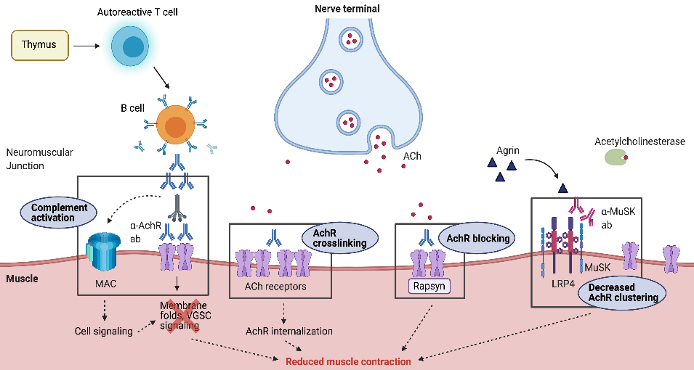
Mechanism of disease
Pathophysiology of anti-AChR+ MG
Autoreactive Th2 T-cell stimulated B-cell response produces high affinity anti-AChR IgG Ab, which results in:
Ab crosslinking and complement activation → ending in MAC formation
Internalization/degradation of surface AChR
Direct blocking of Ach binding to receptor
Pathophysiology of anti-MuSK+ MG
Presence of anti-MuSK IgG4 Ab causes:
Decrease in AChR clustering
Figure adapted from reference #1.
Howard, 2018
Berrih-Aknin, 2014
Conti-Fine, 2006
11
Notes:
References
Howard JF. Myasthenia gravis: the role of complement at the neuromuscular junction. Ann N Y Acad Sci. 2018;1412(1):113-128. doi:10.1111/nyas.13522
Berrih-Aknin S, Frenkian-Cuvelier M, Eymard B. Diagnostic and clinical classification of autoimmune myasthenia gravis. J Autoimmun. 2014;48-49:143-148. doi:10.1016/j.jaut.2014.01.003
Conti-Fine BM, Milani M, Kaminski HJ. Myasthenia gravis: past, present, and future. J Clin Invest. 2006;116(11):2843-2854. doi:10.1172/JCI29894
Notes
Weakness is the result of an antibody-mediated, T cell-dependent immunologic attack directed at proteins in the postsynaptic membrane of the neuromuscular junction (acetylcholine receptors [AChR] and/or receptor-associated proteins).
Healthy neuromuscular junction
The action potential at the presynaptic nerve terminal causes opening of voltage-dependent Ca2+ channels, triggering the release of acetylcholine and agrin into the synaptic cleft. Acetylcholine binds to AChRs, which promote sodium channel opening, triggering muscle contraction. Agrin binds to the complex formed by LRP4 and MuSK, causing AChR clustering; this is required for maintenance of the postsynaptic structures of the neuromuscular junction.
Pathophysiology of anti-AChR+ MG
The three major pathogenic mechanisms of AChR autoantibodies in MG include:
Complement activation at the neuromuscular junction, which causes the formation of MACs on the muscle membrane and destruction of the typical folds in the motor endplate
Antigenic modulation that results in the internalization and degradation of surface AChRs
Binding of AChR antibodies at the AChR ligand binding site, which could directly block ACh binding and, consequently, channel opening
MG with anti-MuSK antibodies accounts for 1-10% of cases.

Slide 12
Signs and symptoms
MG can produce weakness in any skeletal muscle group, but certain presentations are characteristic of MG:
>50% of patients present with ocular symptoms of ptosis and/or diplopia
Many patients without ocular manifestations develop ptosis or diplopia at some point in the disease course
~15% of patients present with bulbar symptoms -- dysarthria, dysphagia, and fatigable chewing
Patients with anti-MuSK MG are more likely to present with early bulbar and respiratory muscle weakness¹
<5% present with proximal limb weakness alone
Less common presentations include:
Isolated neck weakness
Isolated respiratory muscle weakness
Distal limb weakness
Clinical Presentation:
Location:
Ocular MG
Generalized MG
Refractory MG
Thymus Pathology
Age Onset
Pasnoor, et al., 2010
Gilhus, 2016
12
Notes:
References
Pasnoor M, Wolfe GI, Nations S, et al. Clinical findings in MuSK-antibody positive myasthenia gravis: A U.S. experience. Muscle Nerve. 2010;41(3):370-374. doi:10.1002/mus.21533
Gilhus NE. Myasthenia Gravis. Longo DL, ed. N Engl J Med. 2016;375(26):2570-2581. doi:10.1056/NEJMra1602678
Notes

Slide 13
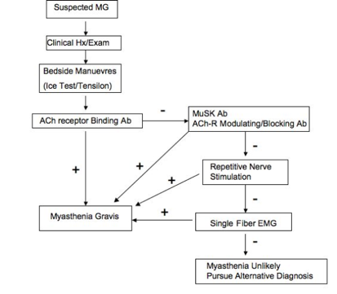
Diagnostic algorithm for MG
Wang, et al., 2007
Mercuri, et al., 2018
Hehir and Ciafaloni, 2011
Notes:
References
1. Hehir MK, Ciafaloni E. Myasthenia Gravis. In: Neuromuscular Disorders. Wiley-Blackwell; 2011:118-125. doi:10.1002/9781119973331.ch16
Notes
The diagnosis of MG can be established by clinical and serologic testing.
The diagnostic approach to myasthenia is focused on confirming the clinical diagnosis established by the history and typical examination findings described above. The most reliable laboratory methods that aid in the confirmation are serologic tests for autoantibodies and electrophysiologic studies (repetitive nerve stimulation studies and single-fiber electromyography [EMG]). The diagnostic sensitivity of these studies also varies considerably depending on whether the patient has ocular or generalized disease. The diagnosis and differential diagnosis of myasthenia gravis are discussed in detail separately.

Slide 14
Diagnostic testing for anti-AChR antibodies
Testing for AChR antibodies is sensitive and specific in generalized MG.
Testing for AChR antibodies is less sensitive in ocular MG.
Antibody | Diagnostic Utility | Thymus Pathology | Additional Considerations
AChR-Binding | Gen MG: Sens: 70-95% Spec: 90+% Ocular MG: Sens: 30-75% Spec: 90+% |  | Rare False Positive: SLE, RA, Autoimmune hepatitis, thymoma w/o MG
AchR-Modulating | Positive in 3-4% of patients with normal AChR-Binding | May be predictive of Thymoma | False positive in hemolysis
AChR-Blocking | Positive in fewer than 1% patients with normal AChR-Binding
Striated Muscle | Gen MG: Sens: 30% | Predictive Thymoma >80% MG with thymoma 24% thymoma w/o MG | More common in elderly patients. False positive in: RA, LEMS, Graft vs. Host
Meriggioli and Sanders, 2005
Benatar, 2006
14
Notes:
References
Meriggioli MN, Sanders DB. Advances in the Diagnosis of Neuromuscular Junction Disorders. Am J Phys Med Rehabil. 2005;84(8):627-638. doi:10.1097/01.phm.0000171169.79816.4c
Benatar M. A systematic review of diagnostic studies in myasthenia gravis. Neuromuscul Disord. 2006;16(7):459-467. doi:10.1016/j.nmd.2006.05.006
Notes

Slide 15
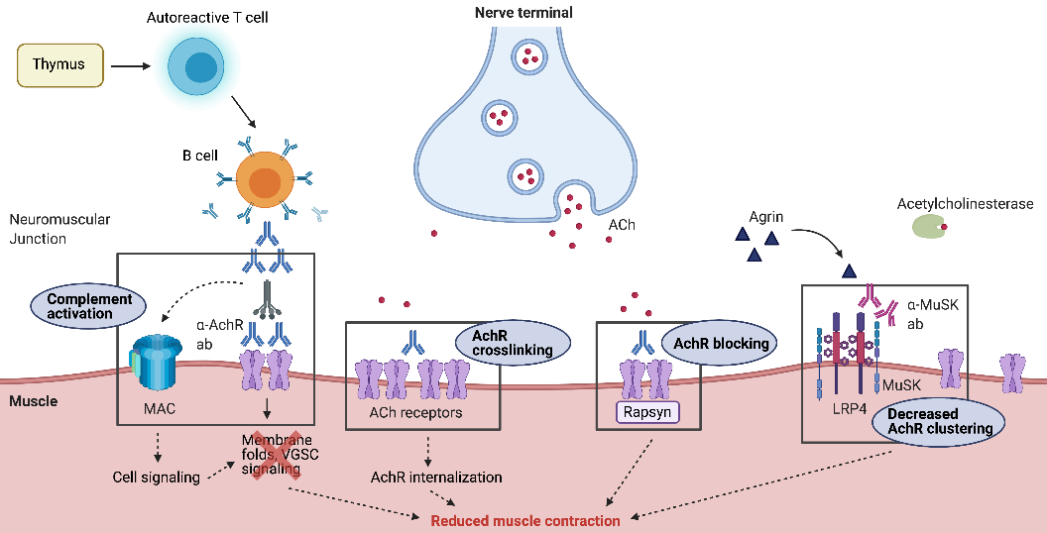
Newer assays for diagnosis of MG
Clustered AChR Cell Based Antibody Assay
Anti-LRP4 (Low Density Lipoprotein 4) Ab
Figure adapted from reference #1.
Table adapted from reference #4.
Howard, 2018
Zisimopoulou, et al., 2014
Rodriguez Cruz, et al., 2015
Vincent, et al., 2018
15
Notes:
References
Howard JF. Myasthenia gravis: the role of complement at the neuromuscular junction. Ann N Y Acad Sci. 2018;1412(1):113-128. doi:10.1111/nyas.13522
Zisimopoulou P, Evangelakou P, Tzartos J, et al. A comprehensive analysis of the epidemiology and clinical characteristics of anti-LRP4 in myasthenia gravis. J Autoimmun. 2014;52:139-145. doi:10.1016/j.jaut.2013.12.004
Rodríguez Cruz PM, Al-Hajjar M, Huda S, et al. Clinical Features and Diagnostic Usefulness of Antibodies to Clustered Acetylcholine Receptors in the Diagnosis of Seronegative Myasthenia Gravis. JAMA Neurol. 2015;72(6):642. doi:10.1001/jamaneurol.2015.0203
Vincent A, Huda S, Cao M, et al. Serological and experimental studies in different forms of myasthenia gravis. Ann N Y Acad Sci. 2018;1413(1):143-153. doi:10.1111/nyas.13592
Notes

Slide 16
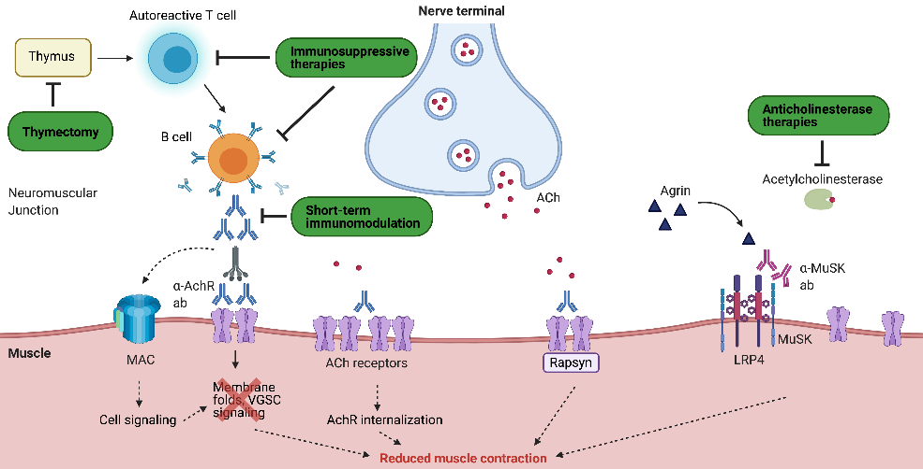
Recommended management guidelines
Current treatment options for MG include:
Symptomatic Treatment:
Acetylcholinesterase inhibitors
Disease Modifying Treatments:
Corticosteroids (e.g. prednisone)
Non-steroid Immune Suppressants (e.g. mycophenolate mofetil and azathioprine)
Intravenous immunoglobulin (IVIG)
Plasma Exchange/Therapeutic Apheresis
Complement Inhibitors (e.g. eculizumab)
Figure adapted from reference #1.
Howard, 2018
Notes:
References
Howard JF. Myasthenia gravis: the role of complement at the neuromuscular junction. Ann N Y Acad Sci. 2018;1412(1):113-128. doi:10.1111/nyas.13522
Notes

Slide 17
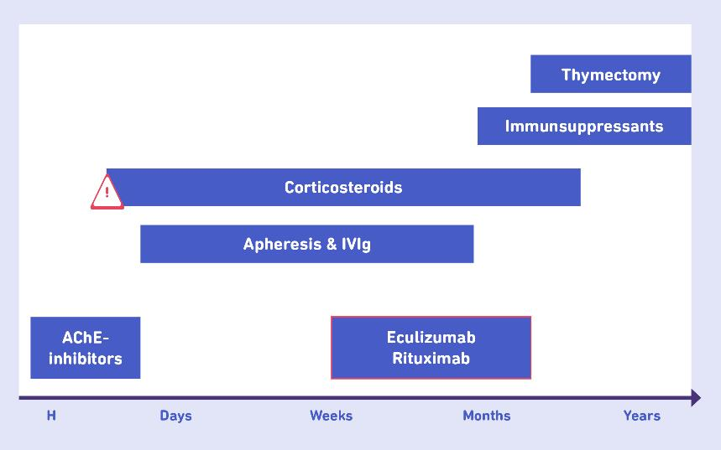
MG Treatment Landscape (2020)
Symptomatic:
Acetylcholinesterase Inhibitors
Pyridostigmine (Mestinon)
Immune-based treatment:
Corticosteroids: Retrospective Data
Azathioprine: RCT and Retrospective
Cyclosporine: RCT and Retrospective
Mycophenolate: RCT Neg
Retrospective Positive
Tacrolimus: Retrospective
Rituximab: Retrospective, RCT expected
IVIG/PLEX: RCT Impending Crisis
Eculizumab: RCT
SC IG: Retrospective, RCT ongoing
Sieb, 2014
Notes:
References
1. Sieb JP. Myasthenia gravis: an update for the clinician. Clin Exp Immunol. 2014;175(3):408-418. doi:10.1111/cei.12217
Notes
Onset of action of the different therapy options in myasthenia gravis:
Administration of acetylcholinesterase inhibitors (AChE) improves muscular weakness for several hours, but does not affect the course of the disease.
At the beginning of corticosteroid therapy there is the risk of deterioration. Long‐term therapy with corticosteroid should be avoided.
With the use of immunosuppressive drugs, such as azathioprine, an effect on the myasthenic symptoms starts after several months of therapy.
Plasma exchange or the intravenous immunoglobulins (IVIg) are used for myasthenic crisis.
Immunosuppressants and apheresis/IVIG both improve myasthenic weakness for just a few weeks.
Thymectomy might beneficially influence the long‐term course of non‐paraneoplastic myasthenia gravis.

Slide 18
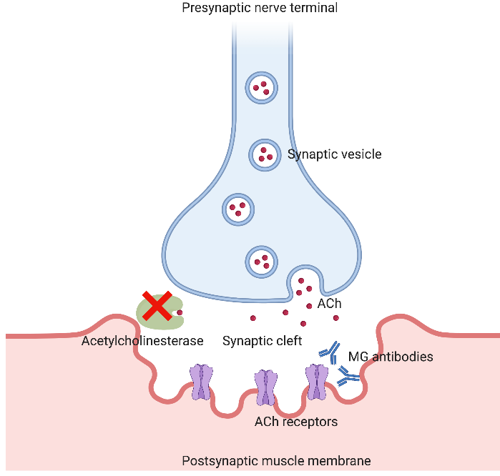
Cholinesterase Inhibitors
Slow breakdown of acetylcholine
Improves strength by increasing competition for limited receptors
Symptomatic treatment only
Goal:
Improvement in strength (e.g. elimination of double vision)
Benefit: 4 – 6 hours
Side Effects:
GI upset
Salivation
If medication is successful, can consider treating side effects (e.g. glycopyrrolate)
Figure adapted from reference #1. Re-created using BioRender.com
Simon, et al. 2015
Acetylcholinesterase
Notes:
References
Simon, R. P., et al. (2015). Clinical Neurology 9/E, McGraw-Hill Education.

Slide 19
Corticosteroids
Dose:
60-100mg daily (1.5-2 mg/kg/day)
Begin taper after strength improved (4-6 weeks)
Initial exacerbation (5 days post treatment initiation)
Results:
80% marked improvement (53%) or remission (27%)
Onset benefit 3 weeks (85%)
Max benefit 2 weeks - 6 years
Problem = Side Effects!
66.7% patients side effects
Include:
Cushing
Weight gain
Diabetes
Osteoporosis
Pascuzzi, et al., 1984
19
Notes:
References
Pascuzzi RM, Coslett HB, Johns TR. Long-term corticosteriod treatment of myasthenia gravis: Report of 116 Patients. Ann Neurol. 1984;15(3):291-298. doi:10.1002/ana.410150316

Slide 20
Immunosuppressants
Azathioprine
Block T cell production
Onset: 12 – 18 months
Typical Dose:
1.5 – 2.5 mg/kg/day (150-250mg)
Goals Therapy:
Improve Strength
Increase relapse free period
Reduce or Eliminate Steroids
63% off prednisone 3 years
Mycophenolate (CellCept/Myfortic)
Reduce production of T and B Cells
Onset: 12 – 18 months
Typical Dose:
1000 – 1500mg twice per day
Goals Therapy:
Improve Strength
Reduce or Eliminate Steroids
50% off prednisone 2 years
70% on low dose prednisone 2 years
Monitor: CBC, hepatic
Side Effects:
Nausea/Diarrhea
Infection
Red/White Blood Cell
Suppression
Monitor: CBC
Hehir, et al., 2010
Palace, et al., 1998
20
Notes:
References
Hehir MK, Burns TM, Alpers J, Conaway MR, Sawa M, Sanders DB. Mycophenolate mofetil in AChR-antibody-positive myasthenia gravis: Outcomes in 102 patients. Muscle Nerve. 2010;41(5):593-598. doi:10.1002/mus.21640
Palace J, Newsom-Davis J, Lecky B. A randomized double-blind trial of prednisolone alone or with azathioprine in myasthenia gravis. Myasthenia Gravis Study Group. Neurology. 1998 Jun;50(6):1778-83. doi: 10.1212/wnl.50.6.1778. PMID: 9633727.
Notes

Slide 21
Thymectomy
In patients with a thymoma and MG, thymectomy should be performed to remove the tumor.
Importantly, a benefit of total thymectomy has been reported for patients with early-onset MG without a thymoma.
Guidelines and consensus statements recommend early thymectomy for:
Early-onset MG
MG in children
Patients with generalized MG who have anti-AChR antibodies and whose symptoms developed at the age of 50-65 years
Current evidence does not support thymectomy in patients with:
MG and anti-MuSK or anti-LRP4 antibodies
Ocular MG
Wolfe, et al., 2017
Gilhus, 2016
Clifford, et al., 2019
21
Notes:
References
Wolfe GI, Kaminski HJ, Aban IB, Minisman G, Kuo HC, Marx A, Ströbel P, Mazia C, Oger J, Cea JG, Heckmann JM, Evoli A, Nix W, Ciafaloni E, Antonini G, Witoonpanich R, King JO, Beydoun SR, Chalk CH, Barboi AC, Amato AA, Shaibani AI, Katirji B, Lecky BR, Buckley C, Vincent A, Dias-Tosta E, Yoshikawa H, Waddington-Cruz M, Pulley MT, Rivner MH, Kostera-Pruszczyk A, Pascuzzi RM, Jackson CE, Garcia Ramos GS, Verschuuren JJ, Massey JM, Kissel JT, Werneck LC, Benatar M, Barohn RJ, Tandan R, Mozaffar T, Conwit R, Odenkirchen J, Sonett JR, Jaretzki A 3rd, Newsom-Davis J, Cutter GR; MGTX Study Group. Randomized Trial of Thymectomy in Myasthenia Gravis. N Engl J Med. 2016 Aug 11;375(6):511-22. doi: 10.1056/NEJMoa1602489. Erratum in: N Engl J Med. 2017 May 25;376(21):2097. [Dosage error in article text]. PMID: 27509100; PMCID: PMC5189669.
Gilhus NE. Myasthenia Gravis. Longo DL, ed. N Engl J Med. 2016;375(26):2570-2581. doi:10.1056/NEJMra1602678
Clifford KM, Hobson-Webb LD, Benatar M, et al. Thymectomy may not be associated with clinical improvement in MuSK myasthenia gravis. Muscle Nerve. 2019;59(4):404-410. doi:10.1002/mus.26404
Notes
For treatment of ocular myasthenia, there is insufficient evidence that surgery prevents generalization or results in remission.
However, it has been argued that thymectomy should be considered for the treatment of ocular MG when drug treatment has failed, the patient has acetylcholine receptor antibodies, and neurophysiological tests indicate a risk of generalized disease.

Slide 22
Refractory Myasthenia Gravis
Approximately 10-15% of patients do not respond adequately to currently available therapies for MG, or they experience intolerable side effects on IST, so are considered to have refractory MG.
Some options exist for individuals with refractory disease:
Eculizumab
Rituximab
Chronic IVIG
Chronic plasma exchange/apheresis
Suh, et al., 2013
Sanders, et al., 2016
Silvestri and Wolfe, 2014
Notes:
References
Suh J, Goldstein JM, Nowak RJ. Clinical characteristics of refractory myasthenia gravis patients. Yale J Biol Med. 2013 Jun 13;86(2):255-60. PMID: 23766745; PMCID: PMC3670444.
Sanders DB, Wolfe GI, Benatar M, et al. VIEWS & REVIEWS International Consensus Guidance for Management of Myasthenia Gravis Executive Summary.; 2016.
Silvestri NJ, Wolfe GI. Treatment-Refractory Myasthenia Gravis. J Clin Neuromuscul Dis. 2014;15(4):167-178. doi:10.1097/CND.0000000000000034
Notes
Patients with refractory disease
10 – 15% generalized MG
Higher % of anti-MuSK MG

Slide 23
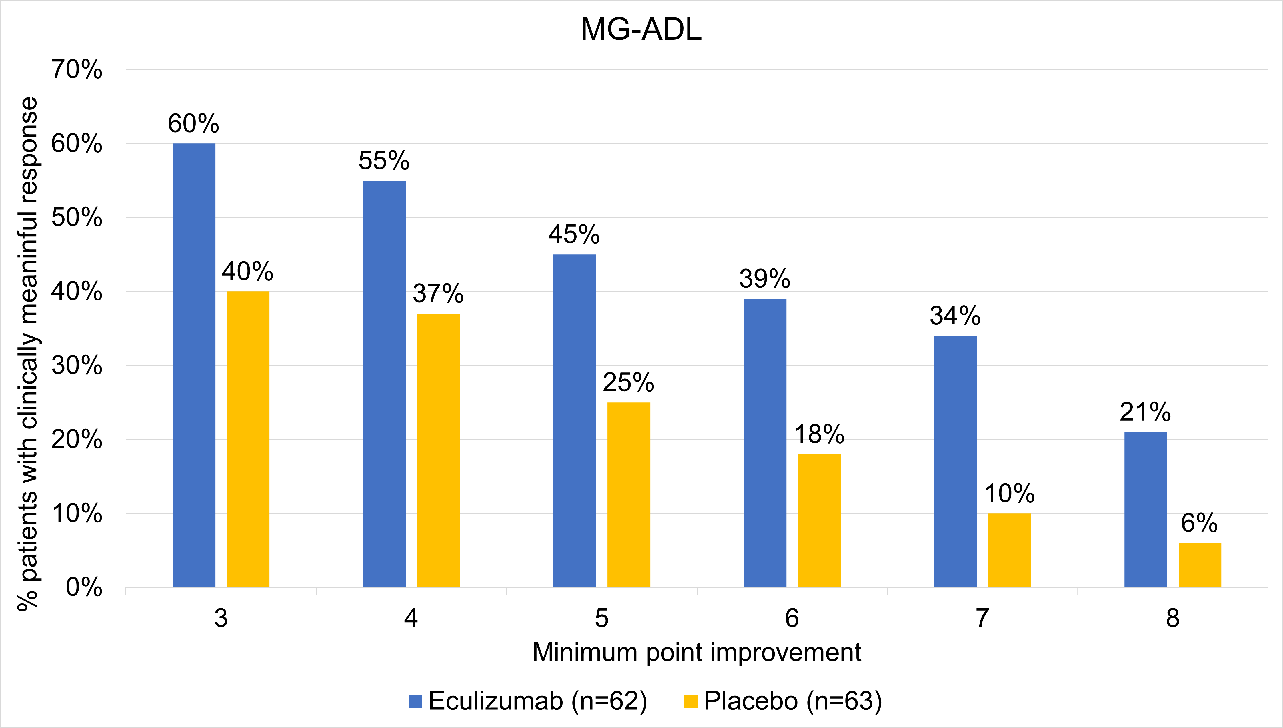
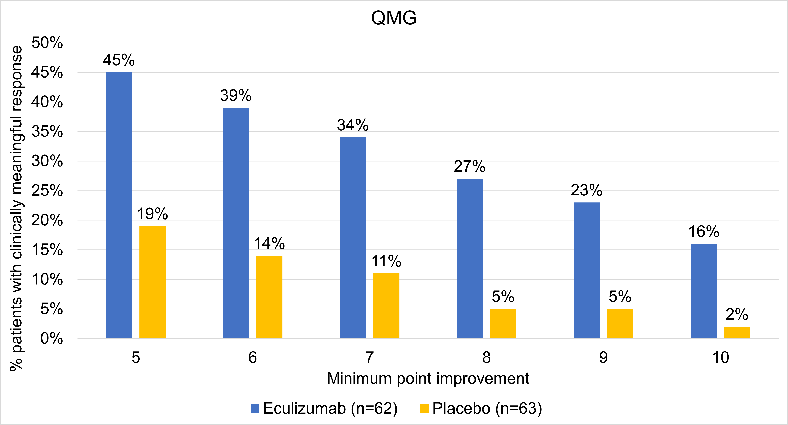
Eculizumab
Approved by the FDA in Oct. 2017 for adult patients with generalized MG who are anti-AchR+.
Typical Treatment
Induction:
900mg IV weekly x 4 weeks
Maintenance:
1200mg IV weekly
Annual Cost
$650,000/year cost to infusion center/hospital
Responder analyses conducted at 26 weeks follow-up. Figures adapted from reference #1.
Howard, et al., 2017
23
Notes:
References
1. Howard JF, Utsugisawa K, Benatar M, et al. Safety and efficacy of eculizumab in anti-acetylcholine receptor antibody-positive refractory generalised myasthenia gravis (REGAIN): a phase 3, randomised, double-blind, placebo-controlled, multicentre study. Lancet Neurol. 2017;16(12):976-986. doi:10.1016/S1474-4422(17)30369-1
Notes
Results from phase 3 REGAIN study evaluating eculizumab vs placebo in patients with refractory generalized myasthenia gravis (n=125). Primary efficacy endpoint was change from baseline Myasthenia Gravis-Activities of Daily Living Score (MG-ADL) score at 26 weeks, evaluated by worst-rank ANCOVA. Quantitative MG (QMG) score change from baseline was evaluated as a secondary endpoint
Primary endpoint was not met: MG-ADL scores did not differ between eculizumab and placebo (p=0.0698). An analysis of QMG scores showed a significant benefit with eculizumab vs placebo (secondary endpoint; p=0.0129)
Graphs show results of secondary analyses of MG-ADL and QMG scores
-A higher proportion of patients achieved a clinically meaningful response with eculizumab than with placebo
-More stringent cutoffs for “clinically meaningful response” were associated with more substantial differences between eculizumab and placebo at each threshold
An emphasis on the proportion of patients who exceed established clinically meaningful differences is especially important in a rare disease.
Black Box:
Patients at higher risk of N. meningitidis
Need vaccines prior to starting infusions. Coordinate with PCP/ID
Group B
Quadravalent

Slide 24
Rituximab
There is no consensus on the role of rituximab in management of AChR antibody and seronegative MG.
Typical Treatment:
375 mg/m2 IV weekly x 4 weeks
Repeat infusions every 6-12 months
(suppresses B-cells)
Monitor CD19/20
Cost to Insurance/Patient:
$80 - $120 K/year
(Assume 2-3 cycles per year)
Table adapted from reference #1.
Tandan, et al., 2017
24
Notes:
References
1. Tandan R, Hehir MK, Waheed W, Howard DB. Rituximab treatment of myasthenia gravis: A systematic review. Muscle Nerve. 2017;56(2):185-196. doi:10.1002/mus.25597
Notes
Phase II Trial of Rituximab in MG
ClinicalTrials.gov ID: NCT02110706
Publication expected 2019-2020
Trial did not meet primary endpoint
Trial excluded MuSK MG patients

Slide 25
Rituximab use for MuSK MG
Rituximab is emerging as an extremely successful treatment for patients with the IgG4 mediated anti-MuSK MG.
Table adapted from reference #1.
Table adapted from reference #2.
Tandan, et al., 2017
Hehir, et al., 2017
Marino, et al., 2020
25
Notes:
References
Tandan R, Hehir MK, Waheed W, Howard DB. Rituximab treatment of myasthenia gravis: A systematic review. Muscle Nerve. 2017;56(2):185-196. doi:10.1002/mus.25597
Hehir MK, Hobson-Webb LD, Benatar M, et al. Rituximab as treatment for anti-MuSK myasthenia gravis. Neurology. 2017;89(10):1069-1077. doi:10.1212/WNL.0000000000004341
Marino M, Basile U, Spagni G, et al. Long-Lasting Rituximab-Induced Reduction of Specific—But Not Total—IgG4 in MuSK-Positive Myasthenia Gravis. Front Immunol. 2020;11:613. doi:10.3389/fimmu.2020.00613
Notes
Scales used:
Post-intervention scale-modified (PIS-m)
MG status and treatment intensity (MGSTI)

Slide 26
MG Crisis
What is Impending Crisis?
Severe worsening of muscle weakness due to MG that could lead to crisis in short team (days to weeks)
Signs/Symptoms:
Shortness of breath at rest. With activity.
Shortness of breath when lying on back
Use of accessory muscles to breathe
Slurred speech
Trouble swallowing secretions
Trouble holding up head
Trouble lifting head up off a bed
Trouble walking or sitting independently
What is Myasthenic Crisis?
Severe muscle weakness due to MG which leads to respiratory failure
Need for mechanical ventilation or non-invasive ventilation (BIPAP)
Sanders, et al., 2016
26
Notes:
References
Sanders DB, Wolfe GI, Benatar M, et al. VIEWS & REVIEWS International Consensus Guidance for Management of Myasthenia Gravis Executive Summary.; 2016.
Notes

Slide 27
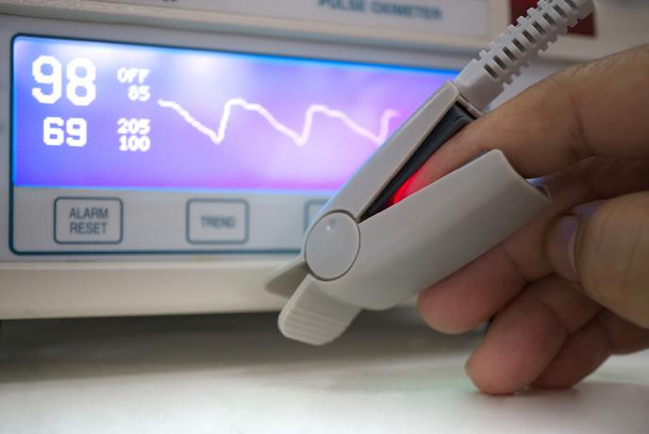
Tests of Patients with Shortness of Breath
Counting in 1 Breath (inability count 20 can indicate severe weakness)
Neck Flexion Strength while Supine
Forced Vital Capacity (FVC)
Mean Inspiratory Pressure (MIP)
Mean Expiratory Pressure (MEP)
Warning:
Pulse oximetry is NOT a reliable indicator of respiratory status in a patient with MG
Good O2 saturation does not mean there is no respiratory compromise in MG
Hypoxia often seen only after life-threatening respiratory failure has already developed
Elsheikh, et al., 2016
Chevrolet and DeleAmont, 1991
Thieben, et al., 2005
27
Notes:
References
Elsheikh B, Arnold WD, Gharibshahi S, Reynolds J, Freimer M, Kissel JT. Correlation of single-breath count test and neck flexor muscle strength with spirometry in myasthenia gravis. Muscle Nerve. 2016;53(1):134-136. doi:10.1002/mus.24929
Chevrolet J-C, DeléAmont P. Repeated Vital Capacity Measurements as Predictive Parameters for Mechanical Ventilation Need and Weaning Success in the Guillain-Barré Syndrome. Am Rev Respir Dis. 1991;144(4):814-818. doi:10.1164/ajrccm/144.4.814
Thieben MJ, Blacker DJ, Liu PY, Harper CM, Wijdicks EFM. Pulmonary function tests and blood gases in worsening myasthenia gravis. Muscle Nerve. 2005;32(5):664-667. doi:10.1002/mus.20403
Notes

Slide 28
Triggers of MG Crisis
Illness
Infection
Surgery
Reduced Dosage of MG Medications
Exposed to medication which may worsen MG
Pregnancy
Stress
Heat
No identified trigger
Gummi, et al., 2019
28
Notes:
References
1. Gummi RR, Kukulka NA, Deroche CB, Govindarajan R. Factors associated with acute exacerbations of myasthenia gravis. Muscle Nerve. 2019;60(6):693-699. doi:10.1002/mus.26689
Notes

Slide 29
Medications that May Worsen MG
Some medications may worsen MG symptoms and should be avoided or used with caution:
Magnesium
IV steroids
Cardiac drugs: beta-blockers, calcium channel blockers, procainamide
Common antibiotics:
Quinolones (e.g. ciprofloxacin, levofloxacin, moxifloxacin)
Aminoglycosides (e.g. gentamycin, neomycin)
Macrolides (e.g. azithromycin “Z-pack”, clarithromycin, erythromycin, telithromycin)
Neuromuscular blocking agents: especially non-depolarizing agents such as cisatracurium and rocuronium
Immune system checkpoint inhibitors (e.g. pembrolizumab)
The Myasthenia Gravis Foundation of America (MGFA) website provides a list a of drugs that may worsen disease:
https://myasthenia.org/MG-Community/MyMG-App
https://myasthenia.org/What-is-MG/Drugs-and-MG
29
Notes:
References
Cautionary Drugs. Accessed November 19, 2020. https://myasthenia.org/Newly-Diagnosed/Drugs-MG
Myasthenia Gravis Foundation of America > MG Community > MyMG App. Accessed November 19, 2020. https://myasthenia.org/MG-Community/MyMG-App
Notes
If in doubt, call your neurologist!
Notes

Slide 30
Medical Management MG Crisis
Plasma Exchange/Apheresis:
5 – 6 Exchanges (Every other day)
Intravenous Immunoglobuin (IVIG):
2 gm/kg over 2 - 5 days
Ineffective in anti-MuSK
Corticosteroids:
Avoid as initial therapy
Expect worsening in MG for 5 – 7 days
Sieb, 2014
Barth, et al., 2011
30
Notes:
References
Sieb JP. Myasthenia gravis: an update for the clinician. Clin Exp Immunol. 2014;175(3):408-418. doi:10.1111/cei.12217
Barth D, Nabavi Nouri M, Ng E, Nwe P, Bril V. Comparison of IVIg and PLEX in patients with myasthenia gravis. Neurology. 2011;76(23):2017-2023. doi:10.1212/WNL.0b013e31821e5505
Notes
Prognosis
Contemporary mortality from MG is low: <5%
Duration Mechanical Ventilation Neuromuscular Patients:
All NM Patients:
Median 9 days ( 1-109 days)
MG: 5 days (1 -34)
Duration ICU Stay:
All NM Patients:
Median 16 days (1-111)
MG: 9 days (2-41)

Slide 31
Tapering of Immunosuppressant Therapy
Guidelines for MG therapy recommend the tapering of corticosteroids and immunosuppressants to prevent risk of long-term side effects.
Tapering of therapies has been associated with some risk of relapse.
Current evidence with CellCept and Azathioprine suggests that tapering of these medications is safe.
Taper medications after period of stability
Slow tapering is best
Sanders, et al., 2016
Hobson-Webb, et al., 2015
Gupta, et al., 2016
Oskarsson, et al., 2016
31
Notes:
References
Sanders DB, Wolfe GI, Benatar M, et al. VIEWS & REVIEWS International Consensus Guidance for Management of Myasthenia Gravis Executive Summary</I
Hobson-Webb LD, Hehir M, Crum B, Visser A, Sanders D, Burns TM. Can mycophenolate mofetil be tapered safely in myasthenia gravis? A retrospective, multicenter analysis. Muscle Nerve. 2015;52(2):211-215. doi:10.1002/mus.24694
Gupta A, Goyal V, Srivastava AK, Shukla G, Behari M. Remission And relapse of myasthenia gravis on long-term azathioprine: An ambispective study. Muscle Nerve. 2016;54(3):405-412. doi:10.1002/mus.25052
Oskarsson B, Rocke DM, Dengel K, Richman DP. Myasthenia gravis exacerbation after discontinuing mycophenolate. Neurology. 2016;86(12):1159-1163. doi:10.1212/WNL.0000000000002405
Notes
Therapy for MG has been associated with lymphoid and other malignancies.
Tapering of therapies is associated with some risk of relapse.
76% Relapse rate after discontinuation of mycophenolate.
Relapse after azathioprine withdrawal.

Slide 32
Multidisciplinary Care
A multidisciplinary approach has shown utility in the management of several neuromuscular diseases.
A multidisciplinary clinic for patients with MG is likely to include the following practitioners:
Neurologist
Nurse
Pharmacist
Research Coordinator
Quality of care for patients with MG depends on navigating complicated treatment options.
32
Notes:
References
Notes

Slide 33
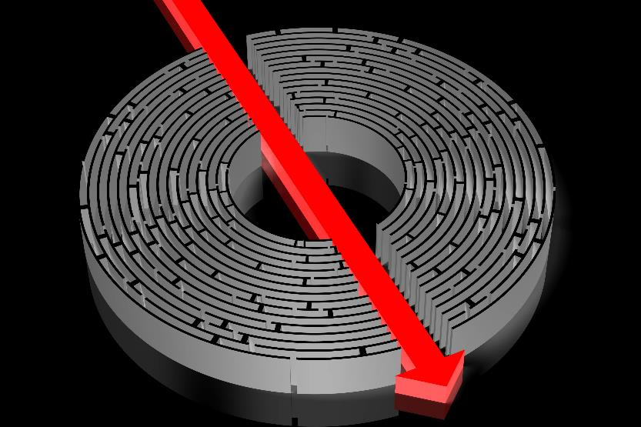
Outcome Metrics in Clinical Practice
Relevant
Meaningful
Reliable
Ease of Use
Ease of Interpretation
Logistical
In the Public Domain
Burns, 2016
33
Notes:
References
1. Burns TM. Using disease-specific, patient-reported measures in everyday clinic. Neurology. 2016;87(9):858-859. doi:10.1212/WNL.0000000000002972
Notes

Slide 34
MG Metrics - Composite Scale
Table adapted from reference #1.
34
Burns, 2012
Notes:
References
1. Burns TM. The MG composite: an outcome measure for myasthenia gravis for use in clinical trials and everyday practice. Ann N Y Acad Sci. 2012;1274(1):99-106. doi:10.1111/j.1749-6632.2012.06812.x
Notes
MG metrics: Composite, ADL, QOL-15r, MG-Impairment Index, MGFA-Post Intervention Status
Medical providers should follow disease specific outcome measures as part of routine care.

Slide 35
MG Metrics - MG-QOL15
Figure adapted from reference #1.
Burns, et al., 2008
35
Notes:
References
Burns TM, Conaway MR, Cutter GR, Sanders DB. Less is more, or almost as much: A 15-item quality-of-life instrument for myasthenia gravis. Muscle Nerve. 2008;38(2):957-963. doi:10.1002/mus.21053
Notes

Slide 36
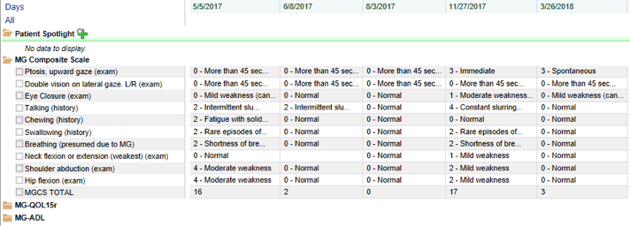
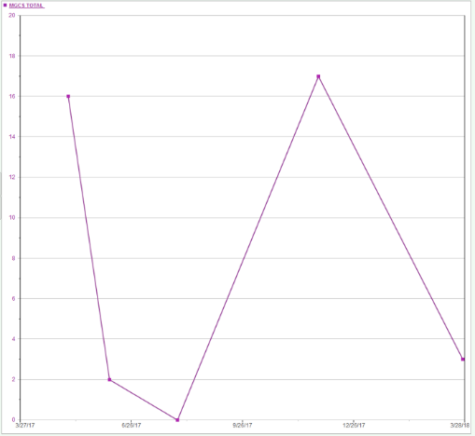
Practical Use of MG Metrics – EMR Data
It is important to follow MG metrics over time. In this example, use of MG composite from EMR data demonstrates response to therapy.
79 year old Dairy Farmer w/ Generalized AChR MG
Bulbar, Respiratory, Limb Weakness
Treatments:
Prednisone = Severe Depression
CellCept = Insomnia
Imuran = Severe Oral Ulcers
Now on standing IVIG for disease management
MG Composite Score used for Insurance
IVIG
2gm/kg
IVIG
Lost to Follow-up
IVIG
IVIG
IVIG
36

Slide 37
Experimental Therapies On the Horizon
Table adapted from reference #1.
Farmakidis, 2020
Notes:
References
1. Farmakidis C, Dimachkie MM, Pasnoor M, Barohn RJ. Immunosuppressive and immunomodulatory therapies for neuromuscular diseases. Part II: New and novel agents. Muscle Nerve. 2020;61(1):17-25. doi:10.1002/mus.26711
Notes
Anti-B cell therapies like rituximab
Other monoclonal antibodies that work on the complement system, including:
ravulizumab — which requires less frequent infusions than eculizumab
zilucoplan, which can be delivered subcutaneously rather than infused.
Ongoing clinical trials of molecules that block the neonatal fc receptor, which dramatically reduces the amount of IgG antibodies

Slide 38
Future directions
Awaiting results of multiple phase 2 and 3 studies for drug candidates
Trial of weaning immunosuppressants in stable patients
Epigenetics, metabolomics
Information about active clinical trials can be found at:
https://myasthenia.org/Research/Clinical-Trials
https://www.clinicaltrials.gov
Notes:
References
1. Myasthenia Gravis Clinical Trials | MGFA. Accessed November 19, 2020. https://myasthenia.org/Research/Clinical-Trials
Notes
Additional areas for future research:
Assistive technologies – magnetic devices, etc.
Anti-sense drugs
Vaccines

Slide 39
Thank You

