Slide 1
Genetic Approaches to DMD Therapy

Slide 2
Russell J. Butterfield, MD, PhD
Associate Professor of Pediatric Neurology
University of Utah Health, Primary Children’s Hospital, and
Shriners Hospitals for Children, Salt Lake City, UT
Director, Utah Program for Inherited Neuromuscular Disorders

Slide 3
Program Objectives
Appreciate the need for a working knowledge of genetics in the evolving treatment landscape for Duchenne muscular dystrophy (DMD)
Identify the specific challenges of the DMD gene as they relate to the development of genetic therapies
Understand the unique aspects of approved genetic therapies and emerging therapies
Effectively counsel patients and their families about available and upcoming genetic therapies for DMD

Slide 4
Program Agenda
Genetics of DMD
2. Mechanisms and Challenges of Genetic Therapies
Advancements Focused on the Underlying Cause of DMD
Nonsense Read-Through
Exon Skipping
Gene Replacement Therapy
Gene Editing
4. Current and Evolving Treatment Landscape

Slide 5
1. Genetics of DMD

Slide 6
DMD Epidemiology and Prevalence
DMD is a rare disease that affects about 1/3000–5000 male births worldwide
X-linked disorder that primarily affects boys
Affected females have variable onset and progression depending on degree of skewed X-inactivation
Female carriers can have cardiac issues in adulthood in absence of muscle weakness
Median life expectancy is between 25–31 years in affected boys, depending on geographic region and care standards

Slide 7
Genetics of DMD
DMD gene
Largest gene in the genome
2.5 million base pairs
mRNA: 14,000 bases (0.56% coding)
Chromosome Xp21
79 exons
Skeletal muscle, cardiac, brain/retina isoforms
De novo mutation in 1/3 of cases
Dystrophin Structure and Promoters
Skeletal muscle
Cardiac
Brain/retina
Retina
Brain
Schwann
Diverse
Dp427
Dp260
Dp140
Dp116
Dp71
Actin-binding domain
H1
H2
H3
H4
Cysteine-rich domain
C-terminal domain
Actin-binding domain
H=hinge
Carrier status (heterozygosity):
10% of female carriers show some disease manifestations that might affect motor and/or cardiac function
Gonadal/germline mosaicism
Negative carrier testing does not mean that a mother has zero risk of passing the mutation to subsequent children

Slide 8
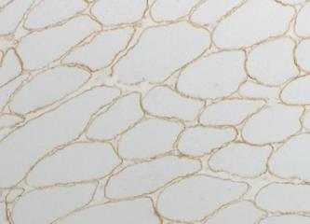
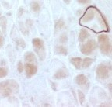
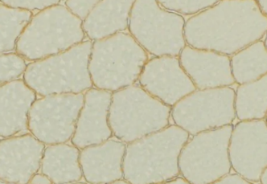
Mutations in DMD Gene Lead to a Spectrum of Phenotypes
Variable Dystrophin Levels
 | Phenotype
Appearance of dystrophin | DMD | Intermediate | BMD
Western blot analysis | Undetectable | Normal/ abnormal detectable amount | Normal/ abnormal detectable amount
Immunohistochemistry | Complete or almost complete absence |  | Normal appearing/ reduced intensity +/– patchy staining
Loss of dystrophin demonstrated with immunohistochemistry
BMD
DMD
Normal
BMD, Becker muscular dystrophy. Komaki R, et al. J Hum Genet. 2020;65(10):903-909.

Slide 9
Types of DMD Mutations
Almost 90% of DMD mutations result in Duchenne phenotype
Type and Frequency of Mutations in the TREAT-NMD DMD Global Database
Type
Percent of Total
Large mutations Deletions (≥1 exon) Duplications (≥1 exon) | 79% 68% 11%
Small mutations (indel) Deletions (<1 exon) Insertion (≥1 exon) | 20% 5% 2%
Splice sites | 3%
Point mutations Nonsense Missense | 50% 10% 0.4%
Mid-intronic mutations | 0.3%
NMD, neuromuscular disease. Bladen CL, et al. Hum Mutat. 2015;36(4):395-402.

Slide 10
Reading Frame Rule
Reading frame rule:
Most of the time, severity (DMD vs BMD) is determined by whether or not the mutation leaves an open reading frame
In-frame mutation
Out-of-frame mutation
Any insertion or deletion of a number of nucleotides that is evenly divisible by 3. Single-nucleotide substitutions are also in-frame mutations.
Any insertion or deletion of a number of nucleotides not divisible by 3, resulting in a disrupted reading frame.
Normal
Normal
… AUC-AAU-CGG-AAA-GAC …
… AUC-AAU-CGG-AAA-GAC …
In-frame insertion
Out-of-frame insertion
… AUC-AAU-CGA-CGG-AAA-GAC …
… AUC-AAU-CCG-GAA-AGA-C …
In-frame deletion
Out-of-frame deletion
… AUC-AAU-AAA-GAC …
… AUC-AAU-GGA-AAG-AC …
CGG
C
Bladen CL, et al. Hum Mutat. 2015;36(4):395-402.

Slide 11
Reading Frame Rule (cont.)
Reading frame rule:
Most of the time, severity (DMD vs BMD) is determined by whether or not the mutation leaves an open reading frame
In-frame mutation
Out-of-frame mutation
Truncated/dysfunctional dystrophin
Absent dystrophin in Duchenne
BMD
DMD
Applies in 90%–95% of cases but not universal
Bladen CL, et al. Hum Mutat. 2015;36(4):395-402.

Slide 12
Exceptions to Reading Frame Rule
Nonsense mutation escape^{1,2}
Trp3X – nonsense mutation in exon 1
North American founder allele
Escape by downstream translation initiation
Nonsense mutation in zero frame exon
Escape by intrinsic exon skipping
Noted throughout the DMD gene – more common in exons 29, 31, and 38
Exons 3-7 deletion
Variety of phenotypes: Becker, intermediate, Duchenne
Escape by downstream transcription initiation in exon 8 and/or intrinsic skipping of exon 8
Reinitiation events might alter consequences of out-of-frame mutations in the N-terminal end of the DMD gene
AUG codons in exon 6 and/or exon 8 might serve as alternative translation initiation sites
1. Flanigan KM, et al. Neuromuscul Disord. 2009;19(11):743-748. 2. Flanigan KM, et al. Hum Mutat. 2011;32(3):299-308.

Slide 13
Genetic Modifiers
Polymorphisms in other genes impact disease progression in DMD
SPP1 (osteopontin)
Extracellular matrix protein; involved in osteoclast formation/bone mineralization
Strongly increased in muscle biopsy samples from patients with DMD
Polymorphism rs28357094
Predictive indicator of loss of ambulation, degree of muscle weakness
LTBP4 (latent TGFβ [transforming growth factor-β] binding protein 4)
4 single-nucleotide polymorphism haplotypes (V194I, T787A, T820A, and T1140M)
Predictive of age at loss of ambulation, onset of dilated cardiomyopathy
CD40 (B-cell surface receptor)
NF-κB (nuclear factor-κB) and TGFβ signaling pathways
Single-nucleotide polymorphism at rs1883832
Predictive of age at loss of ambulation
Others

Slide 14
2. Mechanisms and Challenges of Genetic Therapies

Slide 15
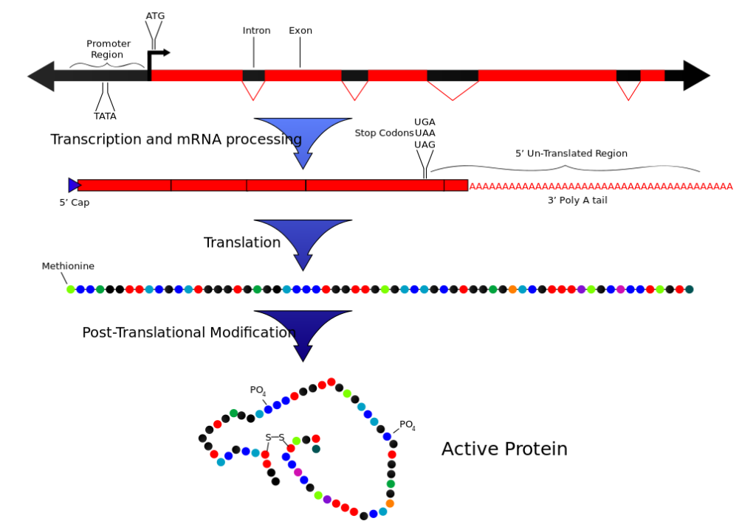
‘Central Dogma’ Guides Therapeutic Targets for Gene Therapy
“Central Dogma” – Information flow in biologic systems
Genetic therapy possible at multiple levels
DNA
Gene replacement
Transcription (RNA)
Disrupt expression or processing
Exon skipping
Translation
Nonsense read-through
Image from https://en.wikipedia.org/wiki/Central_dogma_of_molecular_biology. Original work by Mike Jones for Wikipedia.

Slide 16
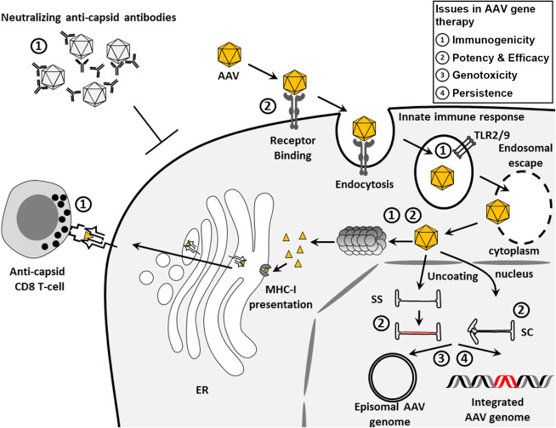
Approaches to Genetic Therapy in DMD
Gene transfer: replace/restore missing or mutated gene
To accomplish gene transfer:
Vehicle (vector)
Adeno-associated virus (AAV)
Different serotypes have different tissue specificity
AAV9, AAVrh74, AAV8 target muscle
Small size limits carrying capacity (~4.5 kb)
Transgene
Construct of the target gene optimized for expression in target tissue
Colella P, et al. Mol Ther Methods Clin Dev. 2017;8:87-104.

Slide 17
ABCs of Gene Therapy: Characteristics of AAV
ITR
ITR
Rep
Cap
AAP
AAV characteristics
Single-stranded DNA human parvovirus
Able to transduce nondividing cells and confer long-term transgene expression
Nonpathogenic in nature without helper virus (AV) for lytic infection
Can package up to 4.6 kb in place of viral Rep and Cap genes
AAP, assembly-activating protein; AV, adenovirus; Cap, capsid; ITR, inverted terminal repeat; Rep, replication.

Slide 18
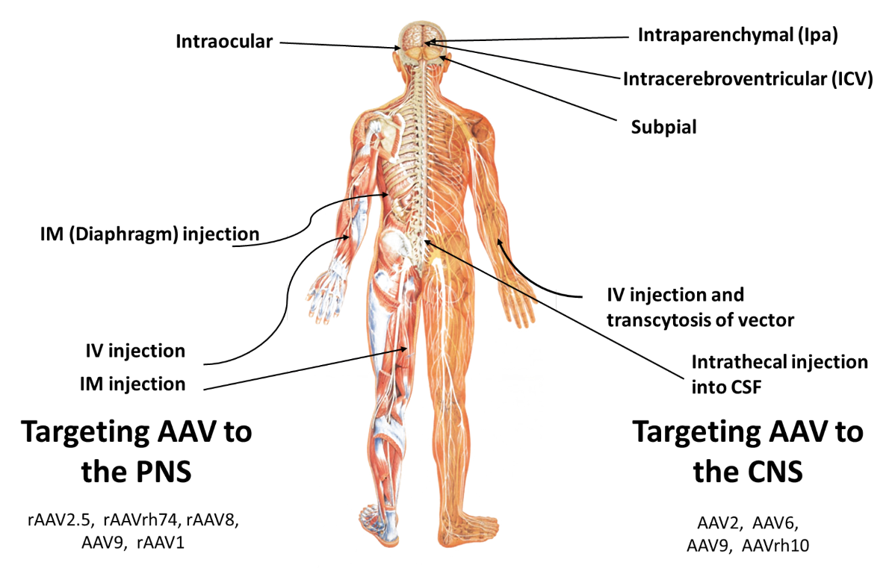
ABCs of Gene Therapy: Targeting Different Tissues
CNS, central nervous system; CSF, cerebrospinal fluid; IM, intramuscular; IV, intravenous; PNS, peripheral nervous system.

Slide 19
ABCs of Gene Therapy: Keys for Effective Gene Transfer
1. Transgene capacity
Cannot exceed packing capacity of vector
2. Transduction efficacy
What dose is needed to transduce a high enough percentage of cells?
Dose limitations/toxicity
3. Stability of transgene expression
How much transgene expression is needed for phenotypic rescue?
5. Cell specificity of vector/promotor
4. Transgene dose
Can you maintain promotor activation?
Risk loss of transgene due to immune response (transgene and capsid)
What is the target?

Slide 20
Success in SMA Treatment
Since 2016, 3 drugs have been approved by the FDA for the treatment of SMA
These treatments have been extremely successful at altering the disease course of SMA
Therapeutic approaches designed to restore protein have not yet translated to DMD
Breakthrough Gene Therapy at Primary Children’s Hospital Helps Little Cowboy Thrive
FDA-approved treatments for SMA
Onasemnogene
abeparvovec-xioi
Nusinersen
Risdiplam
Columbus Boy With Spinal Muscular Atrophy Finds Hope With New Treatment
FDA, US Food & Drug Administration; SMA, spinal muscular atrophy.

Slide 21
Features of a Good Candidate for Gene Therapy: DMD vs SMA
SMA
DMD
Common for a rare disorder (~1:10,000)
Most patients share the same mutation
SMN1/SMN2 and correlation to severity gives clear path to treatment with antisense oligonucleotides (ASOs)
SMN1 is small gene, and AAV9 can easily target neurons
SMA is rapidly progressing, so clinical changes are easy to identify over a short time frame
Patients with SMA express SMN protein at small amounts, so immune tolerance to the transgene is not an issue
Common for a rare disorder (~1:5000 male births)
Some hotspots, but most patients have different mutations
15% nonsense, 8%–10% amenable to exon 51 or exon 53 skipping
DMD is the largest gene in the genome (2.5M bp genomic DNA and 14 kb mRNA)
Progression is slow, so clinical changes are difficult to identify over a short time frame
Patients with DMD do not express dystrophin protein, making them susceptible to an immune response to the expressed transgene

Slide 22
Challenges for Genetic Therapies in Muscular Dystrophy
Fibrosis and fatty replacement in dystrophic muscle tissues make transduction difficult
Muscles make up ~30% to 40% of body weight, making it difficult to get treatment to all muscle tissue
Targeting both cardiac and skeletal muscle can be difficult
Dystrophin protein is the largest protein in the body, with a wide number of intracellular interactions.
Hotta A. J Neuromuscul Dis. 2015;2(4):343-355.

Slide 23
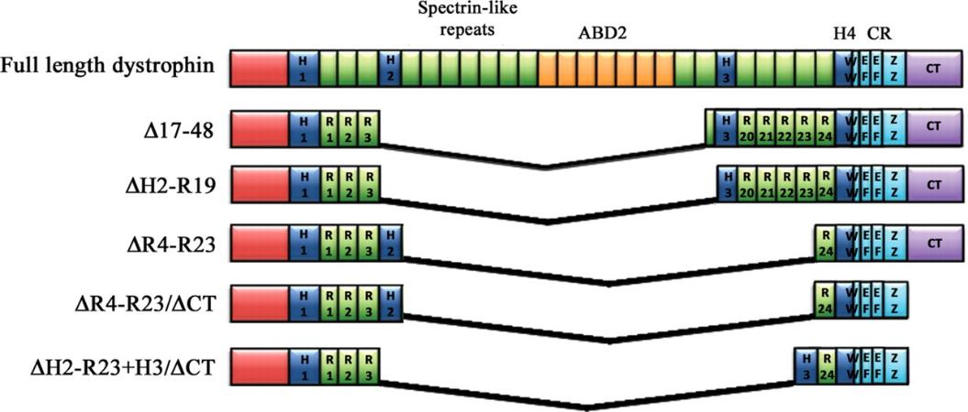
Microdystrohpin/Minidystrophin^{1,2}
AAV vector can hold only 4.7 kb of genetic material
Full-length DMD gene is 2.2 Mb
Fully processed DMD gene is 14 kb
AAV vector only takes ~4.7 kb
Microdystrophin is a smaller construct that maintains function
Based on known mild BMD cases with large deletions but very mild phenotype
1. Davies KE, Guiraud S. Mol Ther. 2019;27(3):486-488. 2. Goyenvalle A, et al. Hum Mol Genet. 2011;20(R1):R69-78.

Slide 24
3. Advancements Focused on the Underlying Cause of DMD
Nonsense Read-Through
Exon Skipping
Gene Replacement Therapy
Gene Editing

Slide 25
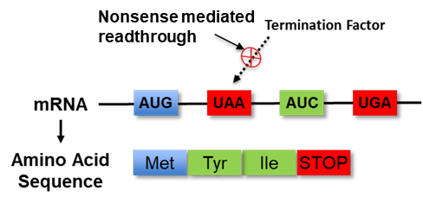
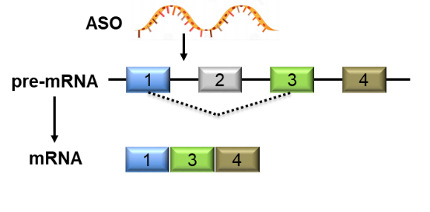
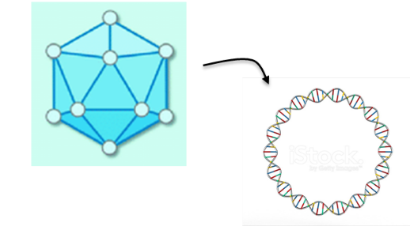
Therapeutic Approaches to Restoring Dystrophin Protein Levels^{1,2}
Nonsense Mutation Readthrough
mRNA Splicing Modifiers
Gene Replacement Therapy
Nonsense mediated readthrough is facilitated by molecules designed to exploit the very rare, natural mechanisms of readthrough
ASOs or small molecules alter the mRNA produced by causing inclusion or exclusion of target sequences
New genetic material is introduced through use of a vector, such as a modified virus (viral vector) or cDNA constructs (nonviral)
cDNA, complementary DNA; mRNA, messenger RNA. 1. Dabrowski M, et al. RNA Biol. 2015;12(9):950-958. 2. Verhaart IEC, Aartsma-Rus A. Nat Rev Neurol. 2019;15(7):373-386.

Slide 26
Therapeutic Approaches to Restoring Dystrophin Protein Levels^{1,2} (cont.)
Nonsense Mutation Readthrough
mRNA Splicing Modifiers
Gene Replacement Therapy
Nonsense mediated readthrough is facilitated by molecules designed to exploit the very rare, natural mechanisms of readthrough
ASOs or small molecules alter the mRNA produced by causing inclusion or exclusion of target sequences.
New genetic material is introduced through use of a vector, such as a modified virus (viral vector) or cDNA constructs (nonviral).
1. Dabrowski M, et al. RNA Biol. 2015;12(9):950-958. 2. Verhaart IEC, Aartsma-Rus A. Nat Rev Neurol. 2019;15(7):373-386.

Slide 27
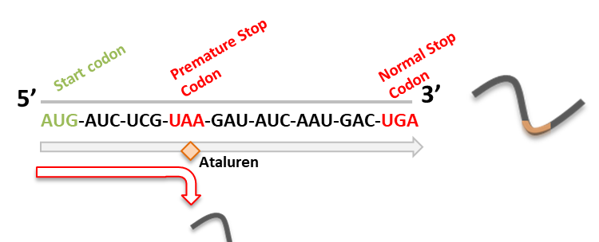
Nonsense Readthrough (Premature Stop Codon)
Targeted to nonsense mutation
Early stop mutation – UGA, UAA, UAG
15% of patients
Observation in the early 2000s that gentamicin disrupts ribosome during translation to ignore nonsense mutation
EMA approval in 2014*
Approved in the European Union, Iceland, Liechtenstein, Norway, Israel, South Korea, Russia
Ataluren-facilitated full-length protein
Premature stop codon leads to a shortened, internally truncated dystrophin protein
*Ataluren is an investigational new drug in the United States and is only available to US patients through clinical trials. EMA, European Medicines Agency.

Slide 28
Therapeutic Approaches to Restoring Dystrophin Protein Levels^{1,2} (cont.)
Nonsense Mutation Readthrough
mRNA Splicing Modifiers
Gene Replacement Therapy
Nonsense mediated readthrough is facilitated by molecules designed to exploit the very rare, natural mechanisms of readthrough
ASOs or small molecules alter the mRNA produced by causing inclusion or exclusion of target sequences
New genetic material is introduced through use of a vector, such as a modified virus (viral vector) or cDNA constructs (nonviral).
1. Dabrowski M, et al. RNA Biol. 2015;12(9):950-958. 2. Verhaart IEC, Aartsma-Rus A. Nat Rev Neurol. 2019;15(7):373-386.

Slide 29
Eteplirsen/Golodirsen/Vitolarsen/Casimersen: ASOs That Modifies Splicing on Dystrophin Pre-mRNA
DMD exon skipping
ASO alters splicing of mRNA to promote excision of target exon
Restores the reading frame
Addresses the underlying cause of DMD by promoting the production of a shorter, but still functional, dystrophin protein to stabilize or slow disease progression
FDA-approved treatments include mutation-specific therapy for ~30% of boys with DMD
Exon 51 skipping (13%)
Exon 53 skipping (8%)
Exon 45 skipping (8%)
Casimersen
Skipping exon 45
41
42
43
44
45
46
47
Shorter, but still functional, dystrophin protein
Shortened, internally truncated dystrophin protein
Eteplirsen
Skipping exon 51
47
48
49
50
51
52
53
Shorter, but still functional, dystrophin protein
Shortened, internally truncated dystrophin protein
Golodirsen/Vitolarsen
Skipping exon 53
49
50
51
52
53
54
55
Shorter, but still functional, dystrophin protein
Shortened, internally truncated dystrophin protein
Additional confirmatory clinical evidence will be required for full approval of all drugs.

Slide 30
Therapeutic Approaches to Restoring Dystrophin Protein Levels^{1,2} (cont.)
Nonsense Mutation Readthrough
mRNA Splicing Modifiers
Gene Replacement Therapy
Nonsense mediated readthrough is facilitated by molecules designed to exploit the very rare, natural mechanisms of readthrough
ASOs or small molecules alter the mRNA produced by causing inclusion or exclusion of target sequences.
New genetic material is introduced through use of a vector, such as a modified virus (viral vector) or cDNA constructs (nonviral)
1. Dabrowski M, et al. RNA Biol. 2015;12(9):950-958. 2. Verhaart IEC, Aartsma-Rus A. Nat Rev Neurol. 2019;15(7):373-386.

Slide 31
Gene Replacement Therapy for DMD Using AAV Vector^{1–3}
AAV/microdystrophin gene therapy: 3 candidates currently in early-phase clinical trials
AAVrh74 vector
Ongoing phase 1/2 study
Topline results released 2/2021
Planned phase 3 blinded controlled trial in 2021
AAV9 vector
Current phase 1/2 clinical trial
Recent restart after FDA hold due to adverse events
AAV9 vector
Current phase 1b open-label trial in ambulatory and nonambulatory participants
Planned phase 3 blinded controlled trial in 2021
SRP-9001
SGT-001
PF-06939926
AAVrh74
SRP-9001
AAV9
SGT-001
AAV9
PF-06939926
1. Fortunato F, et al. J Clin Med. 2021;10(4):820. 2. Shieh PB. Neurotherapeutics. 2018;15(4):840-848. 3. Press Release. Solid BioSciences Inc. Cambridge, MA. https://www.solidbio.com/about/media/press-releases/solid-biosciences-announces-fda-lifts-clinical-hold-on-ignite-dmd-clinical-trial.

Slide 32
Outstanding Questions for Gene-Targeted Therapies
Safety and efficacy of gene transfer have not been established in DMD
There were some serious adverse events in phase 1 clinical trials, including impacts on liver and kidney
Need to understand how to utilize with current treatments (eg, corticosteroids, RNA splicing modifiers are not established)
Further uncertainty on treating milder forms (eg, Becker/intermediate)
Durability of gene transfer is not known; likely to last many years, but there is the potential that the transgene is lost over time
Immunogenicity of the transgene product is unknown and might limit efficacy
Feasibility of repeat dosing for gene transfer therapy is unclear given the immunogenicity
Newborn screening will allow for earlier detection of cases, but not clear how to assess efficacy at younger (paucisymptomatic) stage
A significant number of patients are likely to have antibodies to the AAV vector, limiting access
Multiple available vectors (AAV9 and AAVrh74 will mitigate this somewhat)
Glascock J, et al. J Neuromuscul Dis. 2018;5(2):145-158.

Slide 33
CRISPR – Clustered Regularly Interspaced Short Palindromic Repeats
CRISPR/Cas9 is a gene editing tool that allows precise cleavage and repair of a target sequence
CRISPR was first discovered in the genomes of non–membrane-bound microorganisms (eg, bacteria/archaea)
These sequences are part of the microorganism’s antiviral defense system, where they are used to detect and destroy similar DNA
Several applications are in development for DMD, including repair of missense mutations and induced splicing modulation
Limitations of CRISPR
CRISPR-based therapies are very specifically targeted and will need to be developed separately for different mutations
Primary limitation of therapy development is off-target effects and delivery
1.
2.
3.
Gene mutation
Edited Gene
CRISPR sequence
Sequence Edit

Slide 34
4. Current and Evolving Treatment Landscape

Slide 35
Overview of Current Pharmacological Management of DMD
Initiation of ACE/ARBs
Initiate cough and nocturnal ventilation
Initiation of physical/ occupational therapy
Initiation of corticosteroids
Refer to bone expert at first sign of fracture
Initiation of use of lung volume recruitment
Diagnosis
Early ambulatory
Late ambulatory
Early non-ambulatory
Late non-ambulatory
Initiation* of eteplirsen
Use of standard heart failure interventions with deteriorating health
Initiation* of golodirsen
Initiation* of viltolarsen
Initiation* of casimersen
*Initiation of treatment is likely to be more beneficial, but data only available from limited age range
ACE, angiotensin-converting enzyme; ARB, angiotensin receptor blocker.

Slide 36
Evolving Treatment Landscape
DMD Pipeline
Utrophin Modulators
Myostatin Inhibition
CRISPR
Stem Cells
Anti-fibrotics
Steroid Alternatives

Slide 37
Thank you

