Slide 1
Speaker Slides – What’s New in Genetic Testing
January 6, 2020
*Disclaimer: MDA and the contributing authors are not responsible for any changes, edits and redistribution of this program, and are solely responsible for the original copy only, which may be found on mda.org: https://www.mda.org/science/medical-education-resources

Slide 2
MDA would like to acknowledge
Kristin Engelstad, MS, CGC
of Columbia University School of Medicine
for her support in developing this content.
This program is supported in part by an independent educational grant from Sanofi Genzyme

Slide 3
Clinical Practice Considerations in Neuromuscular Disease (NMD)
More than 500 monogenic disease genes have been identified in NMD and the number is still growing¹
Utilizing genetic testing to arrive at a specific molecular diagnosis is critical to providing high-quality care to patients²
Treating physicians need to be familiar with:
The types of available testing (e.g., single gene testing vs. large gene panels vs. whole exome/genome sequencing
Features that affect the choice of genetic test (e.g., family history, pattern of weakness, associated clinical features, or electrophysiological and pathological findings)³
1. Bonne G, et al. 2018. 2. Kasserdijan CD, et al. 2016. 3. Arnold WD, et al. 2012.
Notes:
References
Bonne, G., F. Rivier and D. Hamroun (2018). "The 2019 version of the gene table of neuromuscular disorders (nuclear genome)." Neuromuscul Disord 28(12):1031-1063.
Kassardjian, C. D., A. A. Amato, A. J. Boon, M. K. Childers, C. J. Klein and A. P. P. Committee (2016). "The utility of genetic testing in neuromuscular disease: A consensus statement from the AANEM on the clinical utility of genetic testing in diagnosis of neuromuscular disease." Muscle Nerve 54(6):1007-1009.
Arnold, W. D. and K. M. Flanigan (2012). "A practical approach to molecular diagnostic testing in neuromuscular diseases." Phys Med Rehabil Clin N Am 23(3):589-608.
Notes
Monogenic diseases result from modifications in a single gene occurring in all cells of the body. Monogenic diseases can be classified into three main categories: Dominant, Recessive, X-linked.

Slide 4
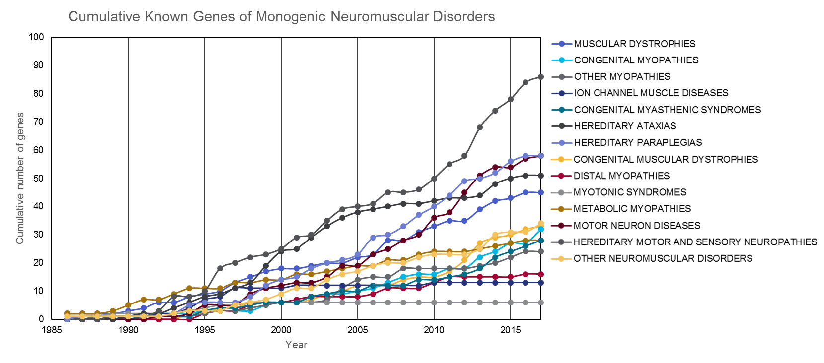
Cumulative Number of Genes Known to Be Associated With NMDs
Hundreds of genes have already been associated with neuromuscular disease.¹
535 different genes to date
Notes:
References
Bonne, G., F. Rivier and D. Hamroun (2018). "The 2019 version of the gene table of neuromuscular disorders (nuclear genome)." Neuromuscul Disord 28(12):1031-1063.
Reilly, M. M. and M. G. Hanna (2002). "Genetic neuromuscular disease." J Neurol Neurosurg Psychiatry 73 Suppl 2: II12-21.
Notes
A table of NMD-associated genes is published annually in the December issue of the journal Neuromuscular Disorders. The online version of the gene table is available at: http://www.musclegenetable.fr
The purpose of the table is to provide an updated list of monogenic NMDs resulting from a defect in a nuclear gene. It comprises diseases in which the causative gene is known or at least localized on a chromosome, if not yet identified. Diseases for which the locus has not been mapped or that are due to defects involving mitochondrial genes are not included.
The diseases are classified into the 16 groups shown in the table.

Slide 5
Importance of Genetic Testing for NMD
Help establish a diagnosis
Shorten diagnostic odyssey – rule out other diseases, confirm suspected diagnosis
Alleviate the need for invasive and painful procedures such as muscle biopsy
Improve the psychological impact on patients and family members by confirming the diagnosis
Mitigate costs by preventing unnecessary procedures and treatments
Help with disease management
Provide a prognosis – i.e., indicate expected severity of disease
Identify patients eligible for treatments
Guide treatment plan
Identify patients eligible for clinical trials
Effects on family members
Guide the testing of relatives
Assist with decisions regarding family planning
Kasserdijan CD, et al. 2016
Notes:
References
Kassardjian, C. D., A. A. Amato, A. J. Boon, M. K. Childers, C. J. Klein and A. P. P. Committee (2016). "The utility of genetic testing in neuromuscular disease: A consensus statement from the AANEM on the clinical utility of genetic testing in diagnosis of neuromuscular disease." Muscle Nerve 54(6):1007-1009.
Notes

Slide 6
Types of Available Genetic Tests
Single gene test
Neuromuscular-associated gene panels
Specific mutation test in a specified gene
Next-generation sequencing (NGS) — Enables efficient and affordable detection of genetic contributors to disease
Whole exome sequencing (WES)
Whole genome sequencing (WGS)
RNA sequencing (RNA-seq)
These tests analyze genes known to be associated with a particular disease
Phenotype-associated evaluation of data generated
These unbiased tests often identify mutations in additional genes that are unrelated to the primary cause of disease (i.e., incidental findings)
Notes:
References
Notes
The possibility of incidental findings with NGS-based methods should be conveyed to the patient/family prior to the test.

Slide 7
Single Gene Tests
Single gene tests are often used when the practitioner is highly confident of a diagnosis and requires confirmation.
Single gene tests can detect the following mutation types:
Nucleotide deletions/insertions
Missense mutations
Nonsense mutations
Splice site mutations
Some single gene tests are specifically designed to test for exon deletions, gene deletions, gene duplications, or repeat expansions
Examples of single gene tests include:
Sequencing of individual genes — Determines the nucleic acid sequence, one base at a time
Southern blotting — Analyzes whether DNA is produced from the gene
PCR-based fragment analysis — Detects well-characterized deletions and amplifications
Multiplex ligation dependent probe amplification (MLPA) — Useful for detecting copy number variations
Notes:
References — A number of reviews discuss the various types of genetic testing available for NMD. A few recent reviews are listed here.
Laing, N. G. (2012). "Genetics of neuromuscular disorders." Crit Rev Clin Lab Sci 49(2):33-48.
Volk, A. E. and C. Kubisch (2017). "The rapid evolution of molecular genetic diagnostics in neuromuscular diseases." Curr Opin Neurol 30(5):523-528.
Orengo, J. P., Murdock, D.R. (2019). "Genetic Testing in Neuromuscular Disorders." Practical Neurology.
Notes

Slide 8
Examples of Single Gene Tests for NMD Diagnosis
Duchenne and Becker muscular dystrophies
Caused by mutations (nonsense, missense, splice site, and exon deletion/duplications) in the DMD gene that encodes the dystrophin protein¹
Deletion/duplication screening by multiplex ligation dependent probe amplification (MLPA) or similar techniques is a first-line diagnostic procedure²
Charcot Marie Tooth (CMT) type 1
70%-80% of individuals with CMT type 1 have a PMP22 gene duplication
Deletion/duplication screening by MLPA or similar techniques is a first-line diagnostic procedure%²
Familial ALS (fALS)
Repeat expansion of a hexanucleotide sequence (GGGGCC) in the C9orf72 locus is a major cause of fALS. C9orf72 mutations account for 30-40% of fALS in the US and Europe⁴
Southern blotting is still common for the diagnosis of C9orf2 repeat expansions²
Notes:
References
U.S. National Library of Medicine. (November 2016). "Duchenne and Becker muscular dystrophy." Retrieved August 13, 2019, from https://ghr.nlm.nih.gov/condition/duchenne-and-becker-muscular-dystrophy#genes.
Volk, A. E. and C. Kubisch (2017). "The rapid evolution of molecular genetic diagnostics in neuromuscular diseases." Curr Opin Neurol 30(5):523-528.
U.S. National Library of Medicine. (October 2018). "Charcot-Marie-Tooth disease." Retrieved August 13, 2019, from https://ghr.nlm.nih.gov/condition/charcot-marie-tooth-disease#genes.
U.S. National Library of Medicine. (March 2016). "Amyotrophic lateral sclerosis." Retrieved August 13, 2019, from https://ghr.nlm.nih.gov/condition/amyotrophic-lateral-sclerosis#genes.
Notes

Slide 9
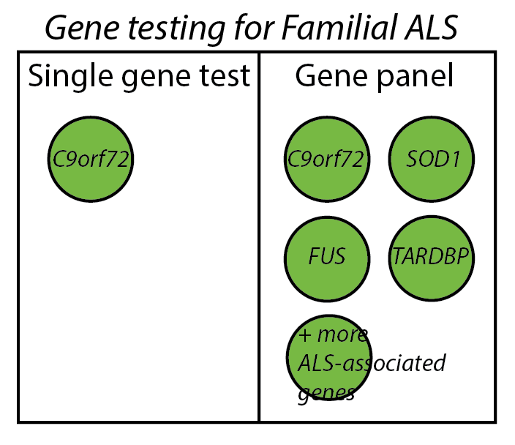
Neuromuscular-Associated Gene Panels
Use of a gene panel is indicated if a causative gene or mutation is not identified during clinical diagnosis of a disorder.
Gene panels can screen patients for gene variants associated with specific NMDs. Some features include:
Custom designs to probe tens to hundreds of genes of interest
High coverage for detection of single nucleotide mutations, small insertions and deletions, and possibly larger copy number variants (e.g., exon deletions)
Next-generation sequencing or solution hybridization approaches
Inclusion/exclusion of genes to maximize diagnostic utility
Minimal time, cost (~$2000-$4000 per panel), and amount of sequence data to be analyzed
Commercial panels that can test several to hundreds of genes
Example of use case:
Workup for potential familial ALS (fALS) — there are more than 20 genes identified as causative for fALS when mutated
Notes:
References — A number of reviews discuss the various types of genetic testing available for NMD. A few recent reviews are listed here.
Laing, N. G. (2012). "Genetics of neuromuscular disorders." Crit Rev Clin Lab Sci 49(2):33-48.
Volk, A. E. and C. Kubisch (2017). "The rapid evolution of molecular genetic diagnostics in neuromuscular diseases." Curr Opin Neurol 30(5):523-528.
Orengo, J. P., Murdock, D.R. (2019). "Genetic Testing in Neuromuscular Disorders." Practical Neurology.
Notes
Gene panels are the most common form of genetic testing for NMD.
One drawback is that gene panels have a short shelf-life because of the rapid discovery of new disease genes with diagnostic value.
Definition
Solution hybridization — Pools of biotinylated oligonucleotide probes, each targeting a segment of the desired capture region, are used to pull down particular pieces of the genome.

Slide 10
Whole Exome Sequencing (WES)
WES analyzes the exons (protein coding regions) of approximately 22,000+ genes using next generation sequencing
WES is considered a less expensive and more practical alternative to whole genome sequencing (WGS)
Exons comprise ~2% of the entire human genome but harbor up to 85% of disease-causing mutations
Can help provide a unifying diagnosis for complex medical issues
Notes:
References — A number of reviews discuss the various types of genetic testing available for NMD. A few recent reviews are listed here.
Laing, N. G. (2012). "Genetics of neuromuscular disorders." Crit Rev Clin Lab Sci 49(2):33-48.
Volk, A. E. and C. Kubisch (2017). "The rapid evolution of molecular genetic diagnostics in neuromuscular diseases." Curr Opin Neurol 30(5):523-528.
Orengo, J. P., Murdock, D.R. (2019). "Genetic Testing in Neuromuscular Disorders." Practical Neurology.
Notes

Slide 11
Use of WES for NMD Diagnosis
Types of available WES testing:
Proband only — Performed on the patient only, often when one or both biological parents are not available for testing
Trio — Testing of the patient and parents. Can narrow the pool of potential disease-causing variants, increasing the speed and likelihood of accurate diagnosis
WES + chromosomal microarray analysis (CMA) — CMA can provide a measure of exon-level copy numbers, as well as SNP analysis for detection of chromosomal abnormalities
WES + NGS of mtDNA — Patients can be screened for pathogenic variants in the mitochondrial genome (mtDNA), prior to WES, if mitochondrial disorder is suspected
Example of use case:
WES was used to search for the genetic cause of limb-girdle muscular dystrophy (LGMD) in a large patient cohort with 45% diagnostic success rate after targeted approaches had failed to identify the genetic cause¹
Trio WES improved the accuracy of diagnosis to about 60%¹
Notes:
References
Ghaoui, R., S. T. Cooper, M. Lek, K. Jones, A. Corbett, S. W. Reddel, M. Needham, C. Liang, L. B. Waddell, G. Nicholson, G. O'Grady, S. Kaur, R. Ong, M. Davis, C. M. Sue, N. G. Laing, K. N. North, D. G. MacArthur and N. F. Clarke (2015). "Use of Whole-Exome Sequencing for Diagnosis of Limb-Girdle Muscular Dystrophy: Outcomes and Lessons Learned." JAMA Neurol 72(12):1424-1432.
Notes
Definitions
Proband — An individual affected with a genetic disorder who is the first subject in a study.
SNP analysis — Detection of single nucleotide polymorphisms (SNPs), which are DNA sequence variations that occur when a single nucleotide (A, T, C, or G) in the genome sequence is altered. Each individual has many SNPs that together create a unique DNA pattern for that person. If a particular SNP occurs in less than 1% of the population, it is considered a mutation. Some SNPs are associated with disease.

Slide 12
Whole Genome Sequencing (WGS)
The advent of NGS has enabled the sequencing of whole genomes (WGS), as well as detection of the genetic causes of some highly heterogeneous diseases
Some features of WGS include:
High cost — while testing prices have been decreasing, this method is still rather expensive
~4-5 million genetic variants detected per sequence
Ability to detect mutations missed by other techniques, e.g., noncoding regions (missed by gene panels and WES), chromosomal rearrangements (missed by MLPA)
This technique is being developed by genetic laboratories and is difficult to interpret so may not be useful at this time
Notes:
References — A number of reviews discuss the various types of genetic testing available for NMD. A few recent reviews are listed here.
Laing, N. G. (2012). "Genetics of neuromuscular disorders." Crit Rev Clin Lab Sci 49(2):33-48.
Biancalana, V. and J. Laporte (2015). "Diagnostic use of Massively Parallel Sequencing in Neuromuscular Diseases: Towards an Integrated Diagnosis." J Neuromuscul Dis 2(3):193-203.
Volk, A. E. and C. Kubisch (2017). "The rapid evolution of molecular genetic diagnostics in neuromuscular diseases." Curr Opin Neurol 30(5):523-528.
Orengo, J. P., Murdock, D.R. (2019). "Genetic Testing in Neuromuscular Disorders." Practical Neurology.
Notes

Slide 13
Use of WGS for NMD Diagnosis
Complexities of the WGS approach include:
Generation of a vast amount of data on genetic variants, which requires intensive filtering and complex interpretation
Incomplete coverage of disease genes
Low reproducibility of repeat expansion and insertion/deletion detection
False positives resulting from mutations introduced by amplification/sequencing
Computationally intensive
Significant time and expertise required to match prioritized variants to patient’s phenotype
Given these difficulties, WGS is not yet used as a routine diagnostic
Rather, WGS is expected to impact the discovery of novel NMD-causing genes that have not been previously described
Notes:
References — A number of reviews discuss the various types of genetic testing available for NMD. A few recent reviews are listed here.
Laing, N. G. (2012). "Genetics of neuromuscular disorders." Crit Rev Clin Lab Sci 49(2):33-48.
Biancalana, V. and J. Laporte (2015). "Diagnostic use of Massively Parallel Sequencing in Neuromuscular Diseases: Towards an Integrated Diagnosis." J Neuromuscul Dis 2(3):193-203.
Volk, A. E. and C. Kubisch (2017). "The rapid evolution of molecular genetic diagnostics in neuromuscular diseases." Curr Opin Neurol 30(5):523-528.
Orengo, J. P., Murdock, D.R. (2019). "Genetic Testing in Neuromuscular Disorders." Practical Neurology.
Notes

Slide 14
RNA Sequencing (RNA-seq)
Diagnostic RNA-seq is a promising tool to bypass some hurdles of NGS-based diagnostics using genomic DNA (e.g., interpreting intronic variants, splice variants, etc.)¹⁻³
RNA-seq provides insight into normal mRNA maturation and expression, as well as perturbations caused by genome alterations
Using RNA-seq, it is possible to:
Detect genetic alterations within expressed regions
Detect monoallelic expression of disease genes
Quantify mRNA expression levels
Detect alternatively spliced transcripts (caused by promoter mutations, intronic mutations, etc.)
A drawback of diagnostic RNA-seq is that invasive tissue sampling may be required to access affected tissue for analysis
RNA-seq is not yet used as a routine diagnostic for NMD
Notes:
References — A number of reviews discuss the various types of genetic testing available for NMD.
Volk, A. E. and C. Kubisch (2017). "The rapid evolution of molecular genetic diagnostics in neuromuscular diseases." Curr Opin Neurol 30(5):523-528.
Cummings, B. B., J. L. Marshall, T. Tukiainen, M. Lek, S. Donkervoort, A. R. Foley, V. Bolduc, L. B. Waddell, S. A. Sandaradura, G. L. O'Grady, E. Estrella, H. M. Reddy, F. Zhao, B. Weisburd, K. J. Karczewski, A. H. O'Donnell-Luria, D. Birnbaum, A. Sarkozy, Y. Hu, H. Gonorazky, K. Claeys, H. Joshi, A. Bournazos, E. C. Oates, R. Ghaoui, M. R. Davis, N. G. Laing, A. Topf, C. Genotype-Tissue Expression, P. B. Kang, A. H. Beggs, K. N. North, V. Straub, J. J. Dowling, F. Muntoni, N. F. Clarke, S. T. Cooper, C. G. Bonnemann and D. G. MacArthur (2017). "Improving genetic diagnosis in Mendelian disease with transcriptome sequencing." Sci Transl Med 9(386).
Kremer, L. S., D. M. Bader, C. Mertes, R. Kopajtich, G. Pichler, A. Iuso, T. B. Haack, E. Graf, T. Schwarzmayr, C. Terrile, E. Konarikova, B. Repp, G. Kastenmuller, J. Adamski, P. Lichtner, C. Leonhardt, B. Funalot, A. Donati, V. Tiranti, A. Lombes, C. Jardel, D. Glaser, R. W. Taylor, D. Ghezzi, J. A. Mayr, A. Rotig, P. Freisinger, F. Distelmaier, T. M. Strom, T. Meitinger, J. Gagneur and H. Prokisch (2017). "Genetic diagnosis of Mendelian disorders via RNA sequencing." Nat Commun 8: 15824.
Notes
Definitions
Monoalleleic expression — When only one of the two gene copies (alleles) is actively expressed (transcribed).

Slide 15
Comparison of Genetic Testing Options
 | Sanger | Panel | mtDNA | Whole exome sequencing | Whole genome sequencing
Technology | Chain termination | NGS | NGS | NGS | NGS
Number of genes tested | 1 | Few hundred | 37 (mitochondrial genome) | 20,000 coding regions | all coding and non-coding regions
Cost
Types of variants detected | Point mutation; InDel | Point mutation; InDel; Duplication | Point mutation; InDel | Point mutation; InDel | Point mutation; InDel; Duplication, Repeats
Potential for VUS | + | ++ | + | +++ | +++++
Notes:
References
Orengo, J. P., Murdock, D.R. (2019). "Genetic Testing in Neuromuscular Disorders." Practical Neurology.
Notes
Single gene tests
Limited by the number of base pairs that can be read at a time. Large genes, introns, and other noncoding regions are often partially read or not read at all
Often focus on known disease-causing mutations and do not identify novel mutation sites
Gene panels
Provide high coverage for detection of single nucleotide variants, small insertions and deletions, and larger copy number variants
Secures that all coding exons of the genes of interest are targeted and that all exons show a sufficiently high coverage
Predominantly use NGS technology to probe genes of interest
NGS approaches
Do not show the same sensitivity/specificity in detecting certain gene alterations (deletions, duplications, repeat expansions, etc.) as traditional single gene tests
NGS generates millions of short reads (100-200 base pairs each) at once, which are then aligned to a reference sequence. This allows for sequencing tens to thousands of genes at once in a far more cost- and time-effective manner
NGS allows improved sequencing depth and coverage, improving discovery power by identifying novel gene variants not previously associated with a disease

Slide 16
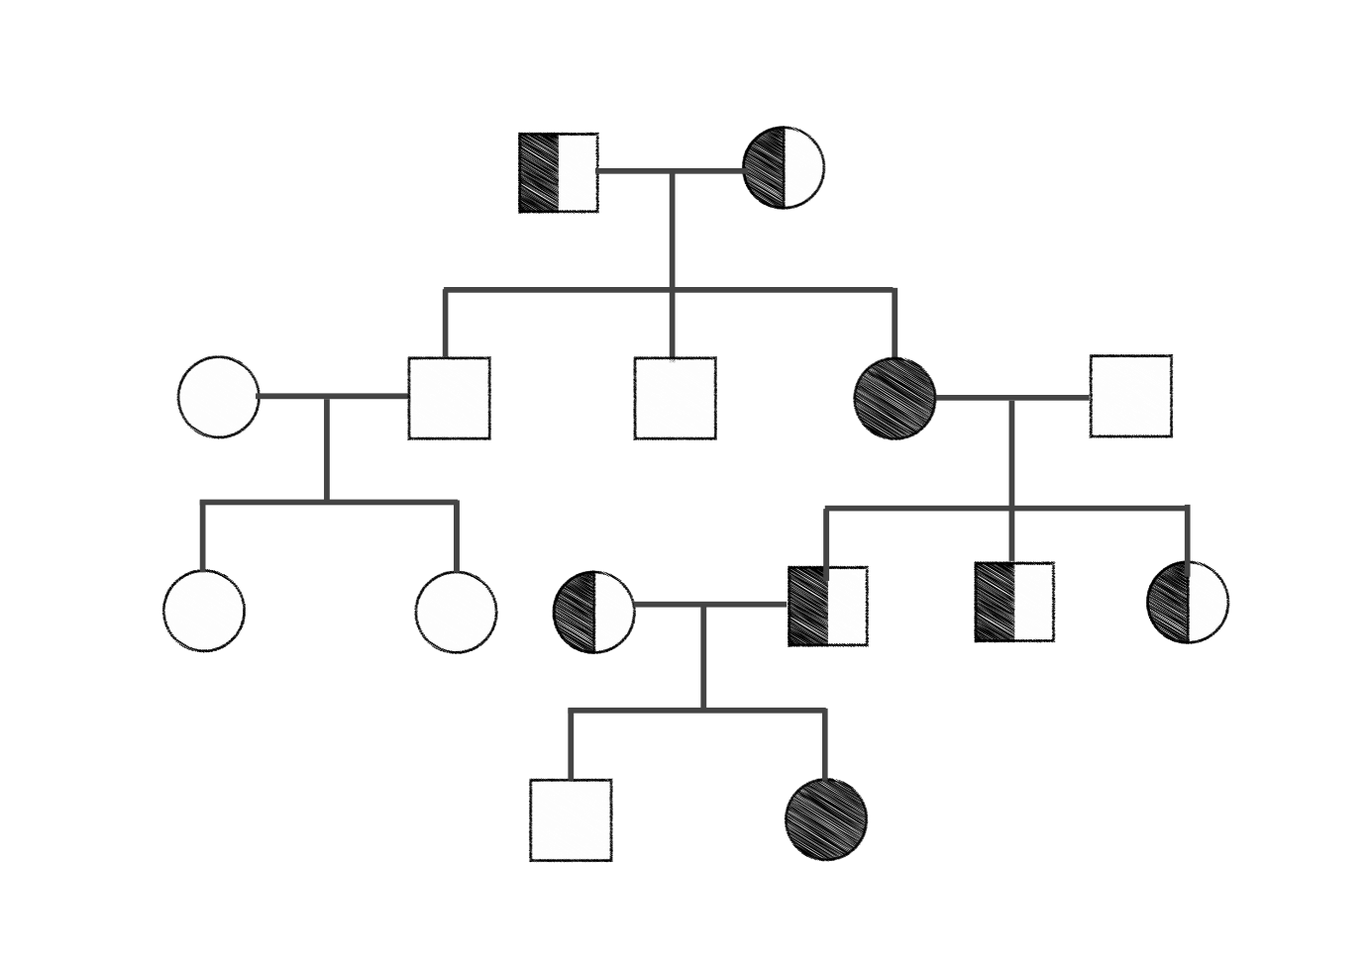
Consideration of Inheritance Patterns
Inheritance patterns describe how a disease is transmitted in families.
Mutated genes can be inherited and can sometimes cause disease in predictable patterns
Known patterns include autosomal dominant, autosomal recessive, x-linked, mitochondrial
Pedigree analysis can help determine the pattern of inheritance of a disease
Knowledge of these inheritance patterns for mutation-driven NMD is critical for:
Understanding genetic reports
Assessing disease risk:
Risk of transmission to offspring
Parental carrier testing and family planning
Risk to siblings
Risk to other relatives
More information about inheritance patterns can be found at: https://ghr.nlm.nih.gov/primer/inheritance/inheritancepatterns
Example of a pedigree analysis
Notes:
References
Notes
Pedigree analysis — The study of affected individuals and carriers over multiple generations of a family.

Slide 17
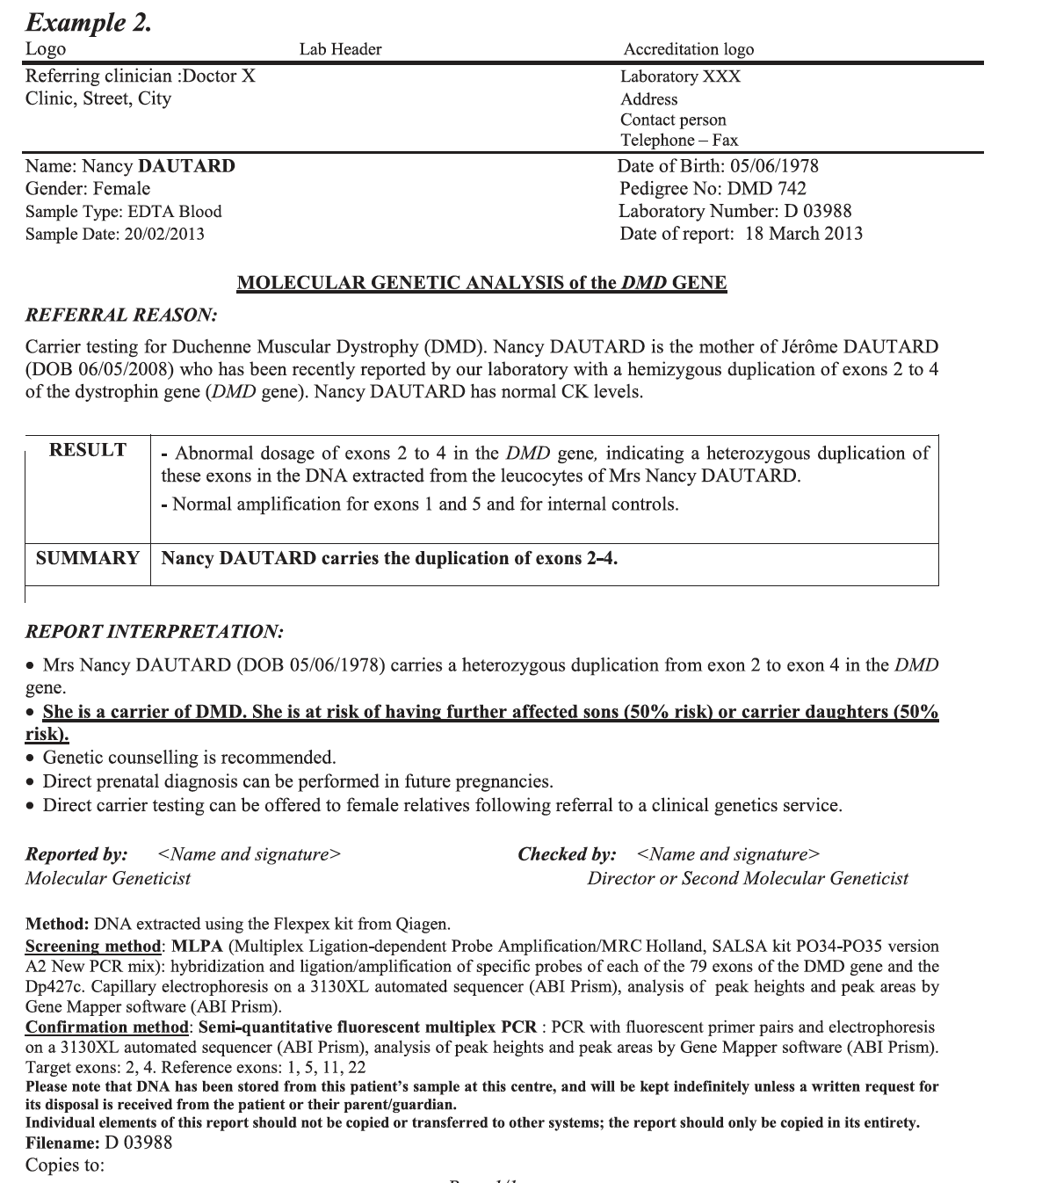
Genetic Reports
Genetic reports typically include the following basic information:
Type of test performed
Whether a mutation was found and in what gene
Name of the mutation
Classification of the mutation (e.g., pathogenic, vus, etc.)
Information about the disease relating to the gene
Typical inheritance pattern
Whether there is free testing for immediate relatives
Notes:
1. Claustres M, Kožich V, Dequeker E, et al. Recommendations for reporting results of diagnostic genetic testing (biochemical, cytogenetic and molecular genetic). Eur J Hum Genet. 2014;22(2):160-170. doi:10.1038/ejhg.2013.125

Slide 18
Types of Pathogenic Variants
Disease-causing variant
Point mutation
Large deletion or duplication
Frameshift mutation
Repeat expansion
Splice site mutations

Slide 19
Point Mutations — Single Nucleotide Variant (SNV)
A point mutation, or single nucleotide variant (SNV), is a change in one base pair
A nonsense mutation leads to a premature stop codon — the shortened protein is not functional
A missense mutation can lead to structural changes, or changes in the activity of the protein, or not cause any effect
A point mutation can also result in a splice site mutation if it occurs at an exon-intron border
Notes:
References
U.S. National Library of Medicine. (August 6, 2019). "What is a gene mutation and how do mutations occur?" Retrieved August 13, 2019, from https://ghr.nlm.nih.gov/primer/mutationsanddisorders/genemutation.
Notes

Slide 20
Deletions and Duplications
Deletion
Duplication
A large deletion can remove an exon or the whole gene leading to absence of the protein
A gene duplication can lead to toxic levels of a protein or no protein product produced

Slide 21
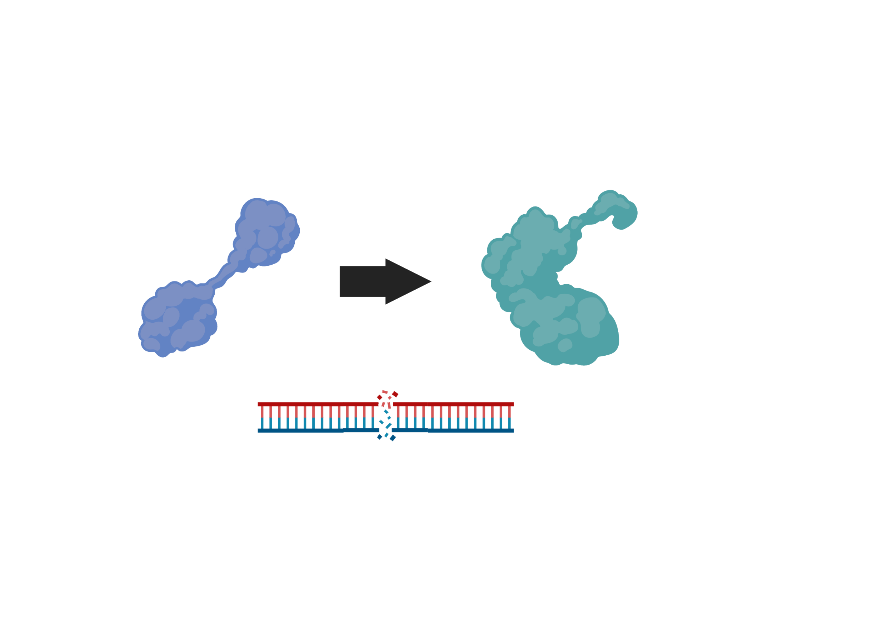
Frameshift Mutations
A frameshift mutation is caused by a small insertion or deletion (sometimes called “indel” — they are often the result of a double strand break)
Frameshift mutations can result in misshapen protein products

Slide 22
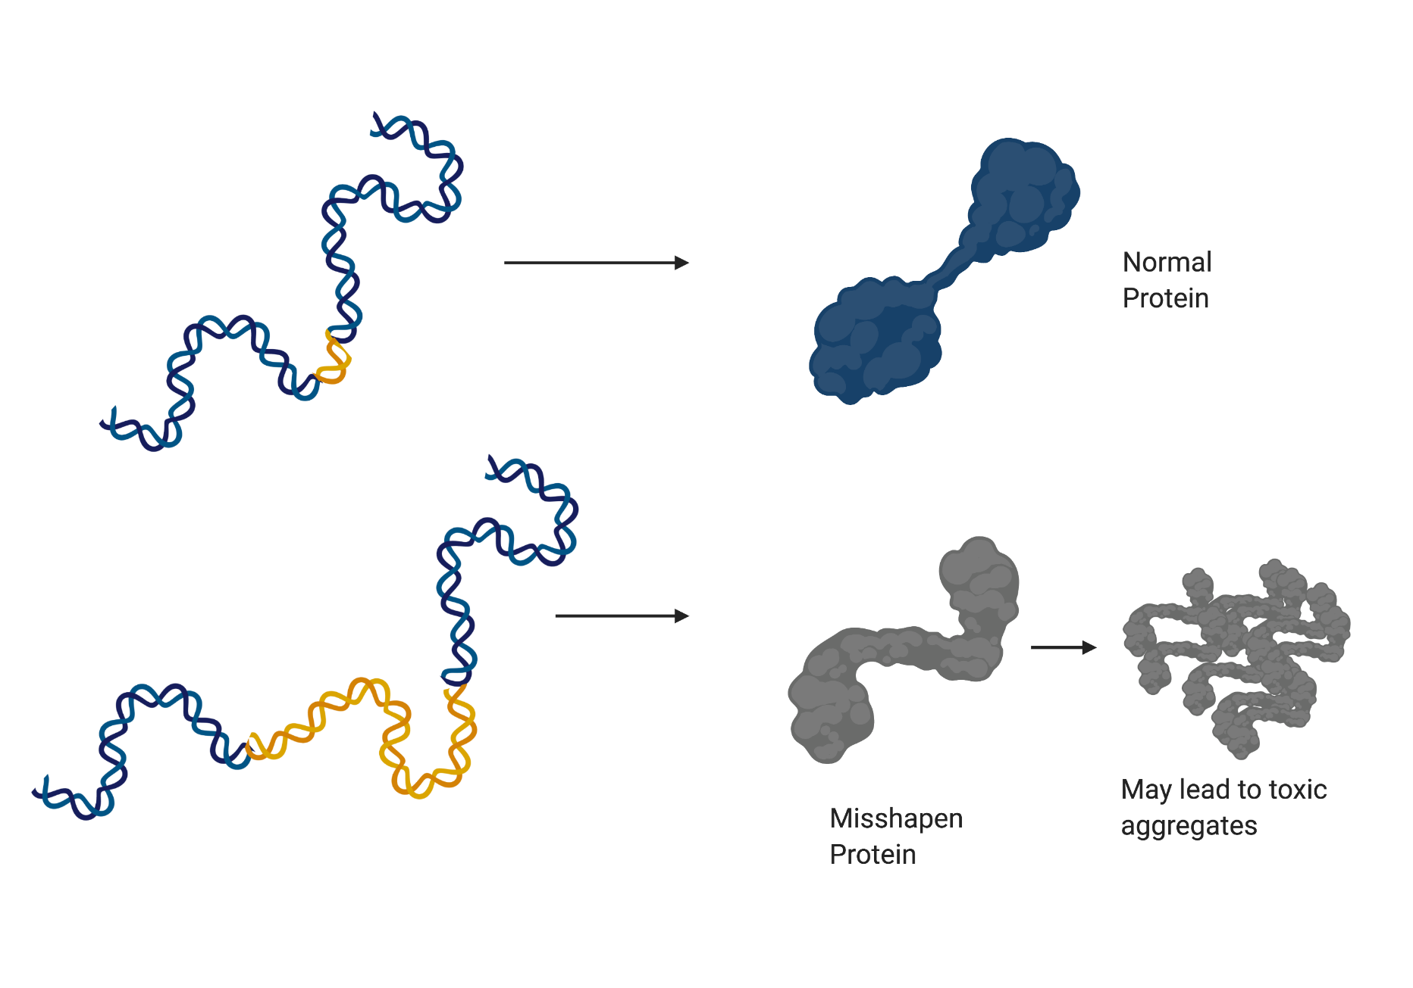
Repeat Expansions
A repeating unit (group of nucleotides) is erroneously repeated more times than in the unmutated gene
﻿In contrast to other mutations, expanded repeats are unstable (dynamic) mutations that often change size in successive generations
Depending on the size of the mutation, repeat expansion diseases can manifest with markedly varied phenotypes
Repeat expansion can destabilize the protein and cause toxicity in the cell
Notes:
1. Paulson H. Repeat expansion diseases. In: Encyclopedic Reference of Genomics and Proteomics in Molecular Medicine. 2018:105-123.

Slide 23
Next Generation Sequencing (NGS)
NGS is used when the doctor is convinced that the underlying basis of disease is genetic but a hypothesis about which gene is causing the NMD cannot be reached because the disease presentation does not fit a characteristic pattern, or a reasonable hypothesis was generated but could not be validated.
In these cases, a switch from a hypothesis-driven approach to a shotgun approach may help with diagnosis. NGS can be used to examine all known genes at once.
Identified variants can be filtered for:
Allele frequencies
Functional impact of variants (e.g., truncating variants, canonical splice site variants)
In-silico predictions
Presence in disease or SNP databases
It is worth noting that around 25% of mutations currently listed as pathogenic in databases are thought to be either common polymorphisms, sequencing errors, or do not show any further evidence of pathogenicity
Sequencing and gene mapping
Reference sequence
... | T | G | A | G | A | T | C | C | T | C | A | C | G | A | G | A | ...
 |  |  |  |  | A | T | C | C | T | C | A | C | G | A | G | A | ...
 |  |  |  | G | A | T | C | G | T | C | A | C | G | A | G | A | ...
... | T | G | A | G | A | T | C | C | T | C | A
... | T | G | A | G | A | T | C | G | T | C | A | C | G | A
... | T | G | A | G | A | T | C | C | T | C | A | C
Sequence reads
Adapted from: Biancalana, V.. 2015. J Neuromuscul Dis
Notes:
References
Biancalana, V. and J. Laporte (2015). "Diagnostic use of Massively Parallel Sequencing in Neuromuscular Diseases: Towards an Integrated Diagnosis." J Neuromuscul Dis 2(3):193-203.
Notes
NGS is used when the doctor is convinced that the underlying basis of disease is genetic but a hypothesis about which gene is causing the NMD cannot be reached. Some reasons for an inconclusive diagnosis include:
Disease presentation does not fit a characteristic pattern.
A reasonable hypothesis was generated but could not be validated.
In these cases, a switch from a hypothesis-driven approach to a shotgun approach may help with diagnosis. NGS can be used to examine all known genes at once.
Identified variants can be filtered for:
Allele frequencies
Functional impact of variants (e.g., truncating variants, canonical splice site variants)
In-silico predictions
Presence in disease or SNP databases
It is worth noting that around 25% of mutations currently listed as pathogenic in databases are thought to be either common polymorphisms, sequencing errors, or do not show any further evidence of pathogenicity.

Slide 24
Complimentary Genetic Testing Programs for NMDs
The Lantern Project (Sanofi Genzyme and PerkinElmer Genomics) — Genetic testing for diagnosis of:
Fabry disease
Pompe disease
Gaucher disease
Niemann-Pick types A and B (ASMD)
Mucopolysaccharidosis I (MPS I) and other MPS disorders
Limb-girdle muscular dystrophy (LGMD) and overlapping myopathies
https://www.perkinelmergenomics.com/lanternproject/
SMA Identified (Biogen and Invitae) — Testing for patients suspected of or clinically diagnosed with SMA
Detects SMN1 whole-gene deletions and sequence variants and quantifies SMN2 copy number. Knowledge of these two alterations together may be useful for prognosis
Biogen does not receive identifiable patient information through this program
https://www.invitae.com/en/sma-identified/
LGMD Rare Genomes Project (MDA and the Broad Institute of MIT and Harvard) — Collaboration to offer free whole-genome sequencing and genetic analysis to individuals whose prior LGMD gene panel testing did not provide a definitive genetic explanation of their disease
https://raregenomes.org/limb-girdle-muscular-dystrophy
Notes:
References
https://www.perkinelmergenomics.com/lanternproject/
https://www.invitae.com/en/sma-identified/
https://raregenomes.org/limb-girdle-muscular-dystrophy
Notes

Slide 25
Complimentary Genetic Testing Programs for NMDs (continued)
Decode Duchenne (Parent Project Muscular Dystrophy [PPMD]) — Testing and counseling to people in the Duchenne or Becker muscular dystrophy community who otherwise could not afford genetic testing. Program includes:
Full analysis of the Duchenne gene through NGS, targeted testing, or repeat testing for those with incomplete testing thus far
Specimen shipping kits and reimbursed blood draw costs when needed
Certified genetic counselors available to providers and families during the testing process
https://www.parentprojectmd.org/about-duchenne/decode-duchenne/
Detect Muscular Dystrophy Program (Invitae) — Free genetic testing and post-test counseling for people suspected of having muscular dystrophy (MD) and who meet eligibility requirements such as a family history or progressive muscle weakness
The tests are carried out by partner pharmaceutical companies
Several types of test panels are offered
Counseling is offered through GeneMatters, a genetic counseling service
https://www.invitae.com/en/detect-muscular-dystrophy/
Notes:
References
https://www.parentprojectmd.org/about-duchenne/decode-duchenne/
https://www.invitae.com/en/detect-muscular-dystrophy/
Notes
Invitae
The DMD program is not meant for carrier screening or unaffected individuals.
In addition to muscular dystrophy, enrollment is open for prostate cancer, lysosomal storage diseases, and cardiomyopathy and arrhythmia. Some of the disease-specific programs also provide follow-up testing to relatives of patients with disease-associated genes to better understand their risk.

Slide 26
Complimentary Genetic Testing Programs for Mitochondrial Disorders
Genetic Testing in Ultra-Rare Mitochondrial Depletion Syndrome (Modis Therapeutics, Inc.) — Thymidine kinase 2 deficiency (TK2d) causes an ultra-rare genetic disease characterized by mtDNA deletions or depletion. TK2d presents similarly to several NMDs. No-cost genetic screening is available for patients, suspected of TK2d.
https://www.tk2d.com/hcp
UMDF Genetic Testing Program (UMDF+ Gene Dx) — On a quarterly basis, one complimentary mtDNA analysis or nuclear gene analysis is offered to patients. The test must be ordered by a physician. To qualify, patients must:
Have a confirmed or suspected diagnosis of mitochondrial disease based on a physician’s clinical assessment
Never have had genetic testing
Be registered in the Mitochondrial Disease Community Registry (MDCR)
Have a financial barrier to receiving genetic testing (e.g., lack of insurance, insurance that does not cover testing, unable to afford the test)
https://www.umdf.org/umdf-genetic-testing-program/
Notes:
References
https://www.tk2d.com/hcp
https://www.umdf.org/umdf-genetic-testing-program/
Notes
Other conditions that may present similarly to TK2d and should also be suspected include:
Spinal muscular atrophy (SMA)
Pompe disease
Other mitochondrial depletion syndromes
Mitochondrial myopathy
Sengers syndrome
Prader-Willi syndrome (PWS)
Congenital myopathies
Congenital myasthenic syndrome
Limb-girdle muscular dystrophy
Fascioscapulohumeral dystrophy (in adults)

Slide 27
Additional No-Charge Genetic Testing Programs
Newborn screening (US public health program) — Blood sample taken from newborn babies is used to detect certain serious and life-threatening genetic diseases for which earlier treatment may contribute to better outcomes
Pompe disease and spinal muscular atrophy (SMA) are included on the national list of diseases recommended for screening (the Recommended Uniform Screening Panel, or RUSP), but screening for these NMDs has not been implemented in every state
https://www.cdc.gov/newbornscreening/index.html
Undiagnosed disorders network (UDN) (National Institutes of Health Common Fund) — UDN brings together doctors and healthcare providers like neurologists, immunologists, nephrologists, endocrinologists, and geneticists to help find the cause of participant symptoms. Genetic testing is performed at the Sequencing Core at Baylor College of Medicine
https://commonfund.nih.gov/diseases
iHope program (United mitochondrial disease foundation (UMDF) + Rare Genomics Institute (RG) + Illumina Inc.) — Provides free trio clinical whole genome sequencing to children affected by rare or undiagnosed diseases. No cost for the sequencing and interpretation
https://www.illumina.com/company/ihope.html
Variants of Uncertain Significance (VUS) (PreventionGenetics) — Free testing for VUS for up to two family members of probands who had full gene sequencing at PreventionGenetics. Free testing for deletion/duplications of uncertain significance discovered by certain methods (aCGH or CMA) for up to two family members of the proband if testing allowed by PCR
https://www.preventiongenetics.com/ClinicalTesting/TestCategory/targetedTesting.php
Notes:
References
https://www.cdc.gov/newbornscreening/index.html
https://commonfund.nih.gov/diseases
https://www.illumina.com/company/ihope.html
https://www.preventiongenetics.com/ClinicalTesting/TestCategory/targetedTesting.php
Notes
Newborn screening
Currently, MDA and other key stakeholders are collaborating on efforts to get DMD added to the Recommended Uniform Screening Panel (RUSP).
UDN
Additional facilities around the US focus on understanding how specific genetic changes contribute to disease (The Model Organisms Screening Center, located at Baylor College of Medicine, Washington University in St. Louis, and University of Oregon), as well as determining which biological markers might be used as predictors of disease (The Metabolomics Core, located at the Mayo Clinic in Rochester, Minn.).
Definitions
Array comparative genomic hybridization (aCGH) — A high-resolution karyotype analysis solution for the detection of unbalanced structural and numerical chromosomal alterations with high-throughput capabilities.
Chromosomal microarray analysis (CMA) — Microchip-based testing platform that uses labels or probes that bond to specific chromosome regions and allows high-volume, automated analysis of many pieces of DNA at once. Computer analysis is used to compare a patient's genetic material to that of a reference sample.

Slide 28
Additional Services for Genetic Diagnosis
The Matchmaker Exchange — A consortium effort launched in October 2013 to create a platform to match cases with similar phenotypic and genotypic profiles. This “exchange” can help identify genetic causes for patients with rare diseases.
For more information, please contact info@matchmakerexchange.org
Additionally, some clinical trials will offer genetic testing free-of-charge to verify that participants meet the inclusion criteria for the study.
Notes:
References
Philippakis AA, Azzariti DR, Beltran S, Brookes AJ, Brownstein CA, Brudno M, Brunner HG, Buske OJ, Carey K, Doll C, Dumitriu S, Dyke SOM, den Dunnen JT, Firth HV, Gibbs RA, Girdea M, Gonzalez M, Haendel MA, Hamosh A, Holm IA, Huang L, Hurles ME, Hutton B, Krier JB, Misyura A, Mungall CJ, Paschall J, Paten B, Robinson PN, Schiettecatte F, Sobreira NL, Swaminathan GJ, Taschner PE, Terry SF, Washington NL, Züchner S, Boycott KM, Rehm HL. 2015. The Matchmaker Exchange: A Platform for Rare Disease Gene Discovery. Human Mutation, 36:915–921. doi:10.1002/humu.22858

Slide 29
Interpreting the Results
Guidance by a genetic specialist can help patients understand the implications of their genetic data and make informed decisions regarding their care. Some considerations include the following:
A specific genetic diagnosis helps to predict the pattern of inheritance. This information is critical for:
Genetic counseling
Informing family planning discussions
Discussions around prenatal diagnosis
Early diagnosis of asymptomatic family members
Variants of unknown significance (VUS)¹ are commonly encountered during genetic testing. The effect of these variants on the function or health of an organism is not known.
Variant interpretation is especially challenging in WGS as more variants are identified, many in intronic regions
General guidelines for interpretation of sequence variants exist, but there is little consensus on how to classify VUS, leading to uncertainty on the pathogenicity of most variants
Recommendations for management of VUS focus on clinical factors, such as personal and family history of cancer
Testing immediate family members (i.e., parents) or affected siblings may provide useful information in interpreting VUS
Notes:
References
1. Richards, S., N. Aziz, S. Bale, D. Bick, S. Das, J. Gastier-Foster, W. W. Grody, M. Hegde, E. Lyon, E. Spector, K. Voelkerding, H. L. Rehm and A. L. Q. A. Committee (2015). "Standards and guidelines for the interpretation of sequence variants: a joint consensus recommendation of the American College of Medical Genetics and Genomics and the Association for Molecular Pathology." Genet Med 17(5): 405-424.
Notes

Slide 30
Importance of Genetic Counseling Pre- and Post-Testing
Prior to genetic testing, it is important that the patient is educated about the test and gives consent to conduct testing.¹
Factors commonly included on an informed consent form include:
A description of the test, including the purpose of the test
What type of sample is required
What the test results mean, including positive and negative results and the potential for false positive/negatives
Whether the results might provide information about family members’ risk of developing a particular condition
How and to whom test results can be disclosed (e.g., health insurance providers)
Acknowledgement that the patient has had the opportunity to discuss the test with a knowledgeable healthcare professional
Following genetic testing, it is recommended that the patient consult with a genetic counselor or a healthcare professional who is knowledgeable about genetics to aid in interpretation of the results. The counselor can:
Explain results to the patient and family
Advise patient about follow-up testing
Educate patient about family risk of disease
Coordinate resource and support groups required by patient
Notes:
References
1. U.S. National Library of Medicine. (August 6, 2019). "What is informed consent?" Retrieved August 14, 2019, from https://ghr.nlm.nih.gov/primer/testing/informedconsent.
Notes
Informed consent
In general, informed consent can be given only by adults who are competent to make medical decisions for themselves. For children and others who are unable to make their own medical decisions (such as people with impaired mental status), informed consent can be given by a parent, guardian, or other person legally responsible for making decisions on that person's behalf.
Informed consent is not a contract, so a person can change his or her mind at any time after giving initial consent.
Genetic counselors can also discuss:
Physical/emotional risks associated with the test
Whether the results can be used for research purposes

Slide 31
Cost and Insurance Issues
Cost considerations
Without insurance, a genetic test can cost thousands of dollars
Genetic counselors can help find companies that offer less expensive tests or complimentary genetic testing programs
Insurance
It is important to contact your insurance company before receiving genetic testing and counseling to ask about coverage
Health insurance plans can cover the costs of genetic counseling and often cover genetic testing when it is recommended by a doctor
Health insurance providers have different policies about which tests are covered. Some providers may require that certain conditions are met before covering genetic testing
Some patients choose not to use insurance to pay for testing because the results of the test can affect a person's insurance coverage
Public insurance plans, such as Medicare, vary on what they cover, however most cover the following:
Genetic testing for chromosomal abnormalities
Prenatal and neonatal diagnosis
Preimplantation genetic diagnosis in some high-risk cases
Notes:
References
Genes in Life. "Reimbursement for Genetic Testing." Retrieved August 14, 2019, from http://www.genesinlife.org/testing-services/testing-genetic-conditions/reimbursement-genetic-testing.
U.S. National Library of Medicine. (August 6, 2019). "Will health insurance cover the costs of genetic testing?" Retrieved August 14, 2019, from https://ghr.nlm.nih.gov/primer/testing/insurancecoverage.
Notes
When a person decides to proceed with genetic testing, a medical geneticist, primary care doctor, specialist, or nurse practitioner can order the test. Genetic testing is often done as part of a genetic consultation.

Slide 32
Family Planning
A genetic diagnosis can help physicians and genetic counselors educate patients or predict risks in a manner that helps guide family planning.
Testing options
Carrier testing of parents — Identifies people who carry a single copy of a known pathogenic mutation that, when present in two copies, causes a genetic disorder. If parents are tested, the test can provide information about their risk of having a child with a genetic condition
Prenatal testing — Detects changes in a fetus's genes or chromosomes before birth. Though not usually performed for neuromuscular conditions, prenatal testing is offered during pregnancy if there is an increased risk that the baby will have a genetic or chromosomal disorder. In some cases, it can lessen a couple's uncertainty or help them make decisions about a pregnancy
Pre-implantation genetic diagnosis (PGD) — Embryos created during in vitro fertilization (IVF) are screened prior to implantation to identify known pathogenic mutations. Only desired embryos are implanted
Family planning alternatives
Sperm/oocyte donation
Adoption
Notes:
References
U.S. National Library of Medicine. (August 6, 2019). "What are the types of genetic tests?" Retrieved August 14, 2019, from https://ghr.nlm.nih.gov/primer/testing/uses.
Notes

Slide 33
Privacy Considerations
Legal considerations:
Patients may choose not to disclose their genetic diagnosis to family members for various reasons
Under HIPAA¹, it is illegal for a doctor to share any “individually identifiable health information” without the patient’s consent
This includes genetic information
HIPAA allows for exceptions when a doctor believes disclosing the protected health information “is necessary to prevent or lessen a serious and imminent threat to a person or the public”
Ethical considerations:
Not all family members need to be tested
A genetic counselor will provide guidance for tests and informing relatives of their increased risk of being a carrier of a known pathogenic mutation
Testing data will remain permanently in medical records
It is important to have a valid reason for testing (e.g., high risk of disease given inheritance pattern, etc.)
Professional recommendations suggest that discussing the reasons to disclose genetic information to at-risk family members prior to genetic testing may address potential barriers to disclosure
Following testing, doctors should explain the reasons for sharing information and assist patients who choose to notify at-risk relatives
Notes:
References
1. Office for Civil Rights. (July 26, 2013). "Summary of HIPAA Privacy Rule." Retrieved August 14, 2019, from https://www.hhs.gov/hipaa/for-professionals/privacy/laws-regulations/index.html.
Notes
If patients choose not to notify family members, doctors typically respect the decision.
In some cases, the doctor may consider overriding the patient's preferences if the family member is judged to be in danger of serious or immediate harm or there is a high likelihood that a dangerous condition can be either prevented or treated with early recognition.
Definitions
HIPAA — The Health Insurance Portability and Accountability Act of 1996.

Slide 34
Carrier Testing
Preconception or prenatal screening
Recommended for autosomal recessive and specific ethnic group conditions (e.g., SMA, cystic fibrosis)
Preconception is the best time to screen as all family planning options are available without the need to make decisions on a current pregnancy
Testing generally starts with the female and if positive will include the male.
Targeted mutation testing — Family members tested for known pathogenic mutation
If both parents are tested, the test can provide information about the risk of having a child with a genetic condition
Notes:
References
U.S. National Library of Medicine. (August 6, 2019). "What are the types of genetic tests?" Retrieved August 14, 2019, from https://ghr.nlm.nih.gov/primer/testing/uses.
Notes

Slide 35
Considerations for Testing Family Members
Examining affected relatives who are earlier or later in the course of their NMD relative to the patient can help confirm a patient’s diagnosis
Testing parents
In some cases (e.g., myotonic muscular dystrophy), testing of a parent can help establish the diagnosis in an affected child
Testing siblings and other relatives
In some cases (e.g., dystrophic myopathies), a genetic or pathologic diagnosis in a sibling or close relative may help establish the diagnosis in a child or adult based on clinical examination and laboratory data, avoiding further invasive testing
Testing of unaffected family members can also provide important information, including:
Their potential for developing disease
Their status as carriers of the disease allele
Their likelihood of passing disease alleles to the next generation
Testing of unaffected family members should occur only after careful consideration of utility and privacy concerns
Testing children
Unless the hereditary condition affects children, most experts recommend allowing children to make the decision to get tested once they turn 18 years or older, understand the implications of testing, and have been fully informed of the pros and cons
Notes:
References
McDonald, C. M. (2012). "Clinical approach to the diagnostic evaluation of hereditary and acquired neuromuscular diseases." Phys Med Rehabil Clin N Am 23(3):495-563.
Notes
Testing parents
In the case of myotonic muscular dystrophy (MMD), genetic anticipation with abnormal CTG trinucleotide expansion of unstable DNA results in progressively earlier onset of the disease in successive generations with increasing severity.
Testing siblings
In the case of dystrophic myopathies, a genetic diagnosis in a relative will call for further creatine kinase or molecular genetic testing in a patient, thus allowing the avoidance of further invasive testing such as a muscle biopsy.

Slide 36
Genetic Information Nondiscrimination Act (GINA)
GINA is a federal law passed in 2008 that protects individuals from the misuse of genetic information (i.e., genetic discrimination) in health insurance and employment. GINA has two parts:
Title I prohibits genetic discrimination in health insurance
Title II prohibits genetic discrimination in employment
The information protected by GINA includes:
Family health history
Results of genetic tests
Use of genetic counseling and other genetic services
Participation in genetic research
GINA’s protections allow patients to talk openly about family health history with healthcare providers and use genetic testing to learn about health risks without fear of genetic discrimination
GINA and other laws do not protect people from genetic discrimination in the following cases:
At an employer that has fewer than 15 employees
People in the US military or others receiving health benefits through the Veterans Health Administration or Indian Health Service
When buying other insurance types, such as life, disability, or long-term care
Notes:
References
U.S. National Library of Medicine. (August 6, 2019). "What is genetic discrimination?" Retrieved August 14, 2019, from https://ghr.nlm.nih.gov/primer/testing/discrimination.
Genetic Alliance, the Genetics and Public Policy Center at Johns Hopkins University, and the National Coalition for Health Professional Education in Genetics. (May 2010). "GINA - Genetic Information Nondiscrimination Act." Retrieved August 14, 2019, from http://www.ginahelp.org/GINAhelp.pdf.
Notes

Slide 37
Finding a Genetic Professional
To learn about the genetics of a particular neuromuscular disorder, a specialist can be consulted
The patient’s treating physician can generally refer the patient to a geneticist, genetic counselor, or other knowledgeable healthcare professional for testing and information
MDA-supported Care Centers can connect patients to genetic specialists
Other resources include:
National Society of Genetic Counselors: https://www.nsgc.org/
Genetic Alliance: http://www.geneticalliance.org/
American College of Medical Genetics and Genomics: Find a Genetic Service: https://www.acmg.net/ACMG/Genetic_Services_Directory_Search.aspx
Testing should be ordered from accredited laboratories, such as those that have received Clinical Laboratory Improvement Amendments (CLIA) certification in the United States
Notes:
References
Notes
For clinicians:
This online database provides current testing availability: www.genetests.org

